Slide 1
TOBACCO / Alcohol /drugs

Slide 2
Tobacco
Addictive Drug- a substance that causes physiological or psychological dependence
Nicotine- the addictive drug found in tobacco leaves
Stimulant- a drug that increases the action of the central nervous system, the heart, and other organs

Slide 3
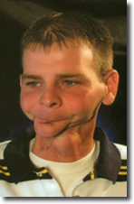
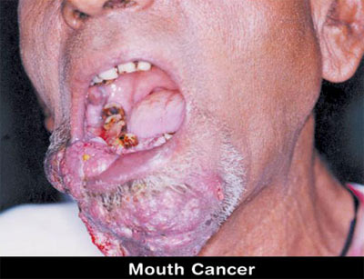
Carcinogen- a cancer- causing substance

Slide 4
Tar
a thick, sticky, dark fluid produced when tobacco burns

Slide 5
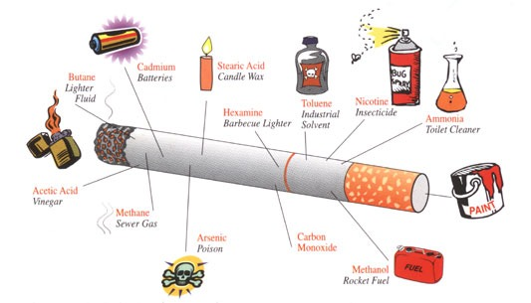
CHEMICALS IN CIGARETTES

Slide 6
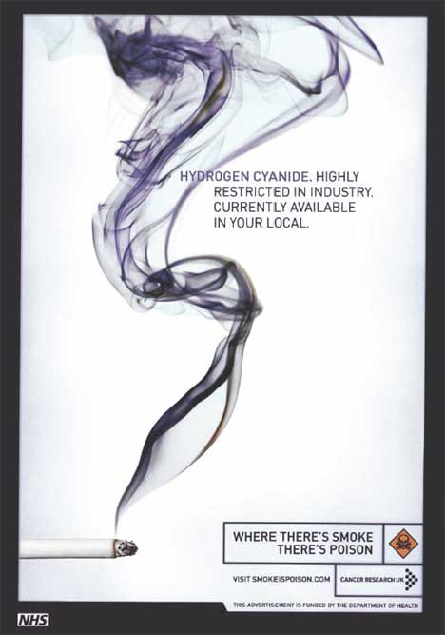
CARCINOGENS IN CIGARETTES
CYANIDE

Slide 7
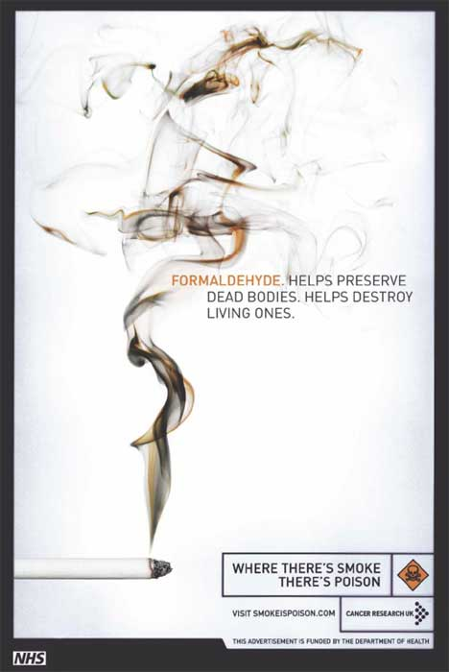
FORMALDEHYDE

Slide 8
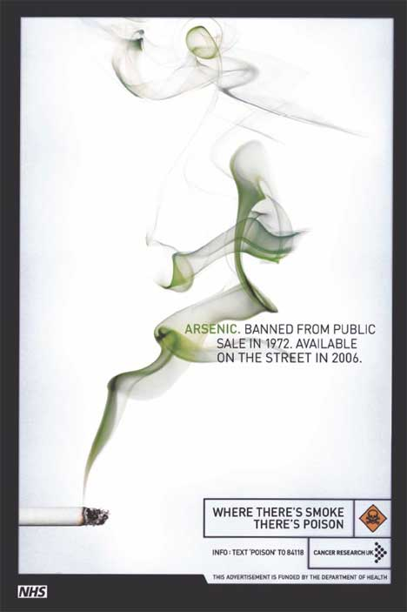
ARSENIC

Slide 9
CHEMICALS IN CIGARETTES
INSECTICIDES
PAINT
TOILET CLEANERS
ANTIFREEZE
EXPLOSIVES

Slide 10
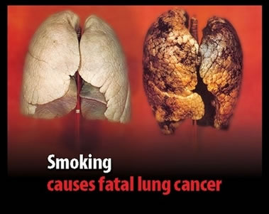
TAR IN SMOKERS LUNGS

Slide 11
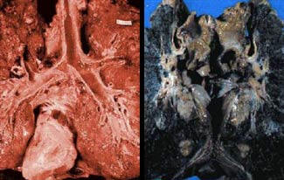
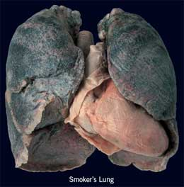

Slide 13
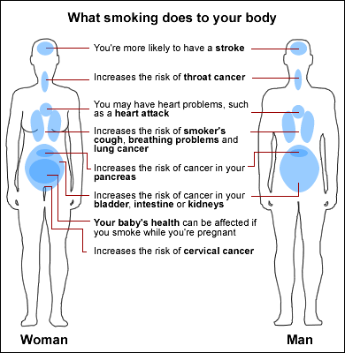

Slide 14
CARBON MONOXIDE
A colorless, odorless, and poisonous gas

Slide 15
Harmful Effects of Pipes, Cigars, and Smokeless Tobacco
Increased risk of developing cancers of the lip, mouth, and throat
Leukoplakia- thickened, white, leathery-looking spots on the inside of the mouth that can develop into oral cancer

Slide 16
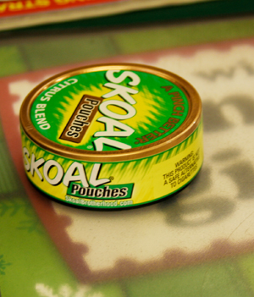
SMOKELESS TOBACCO

Slide 17
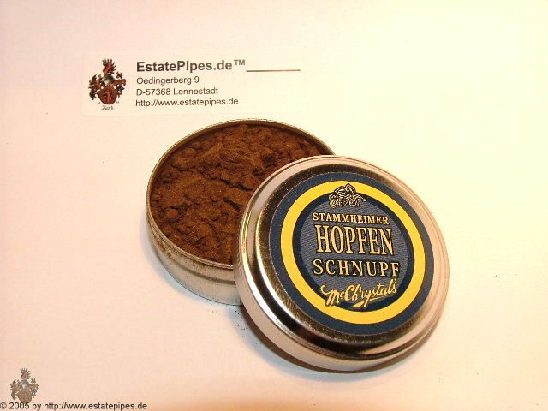

Slide 18
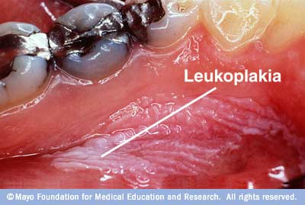

Slide 19
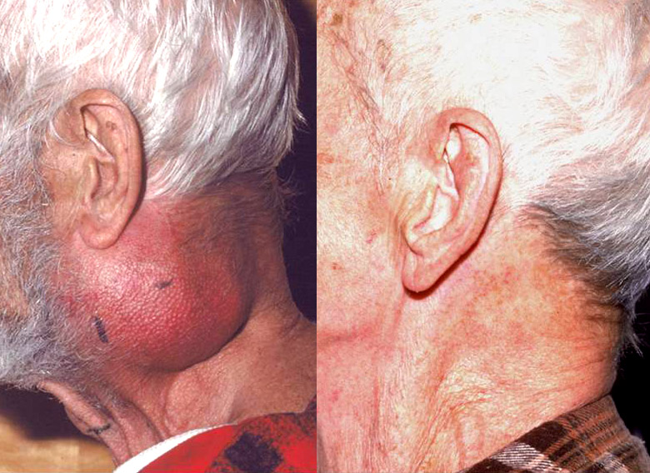

Slide 20
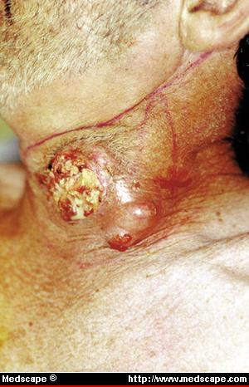

Slide 21
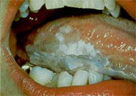

Slide 22
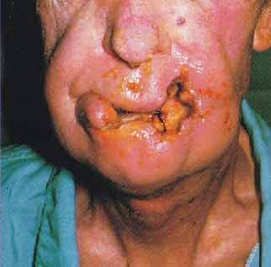

Slide 23
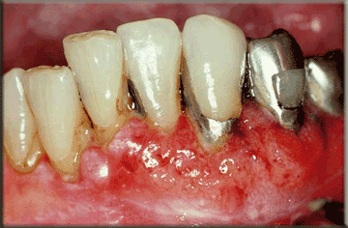

Slide 24
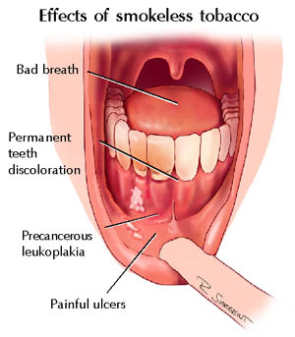

Slide 25
SHORT-TERM EFFECTS OF TOBACCO USE
Changes in brain chemistry
Increased respiration and heart rate
Dulled taste buds and reduced appetite
Bad breath and smelly hair, clothes, and skin

Slide 26
LONG-TERM EFFECTS OF TOBACCO USE
Chronic bronchitis
Chronic coughing and excessive mucus secretion
Emphysema
Destroys the tiny air sacs in the lungs
Lung cancer
Coronary heart disease and stroke

Slide 27
OTHER CONSEQUENCES
LEGAL CONSEQUENCES
Selling tobacco products to persons under the age of 18 is illegal.
Schools prohibit tobacco use on school grounds. Student may be suspended or expelled for breaking these rules

Slide 28
SOCIAL CONSEQUENCES
People find secondhand smoke and the smell of tobacco offensive, so tobacco users may be excluded from social gatherings
Having bad breath, yellowed teeth, and stained fingers may harm the users health

Slide 29
FINANCIAL CONSEQUENCES
Using tobacco products can be very expensive
Someone who smokes a pack of cigarettes a day can spend more than $3,000 each year
Total economic cost of tobacco use to taxpayers in the U.S., including medical cost, is about $97 billion a year

Slide 30
How to Reduce Tobacco Use Among Teens??
Antismoking campaigns
Financial cost
Societal pressures
Family influence

Slide 31
STRATEGIES FOR PREVENTING TOBACCO USE
Choose friends who don’t use tobacco
Avoid situations where tobacco products may be used
Practice and use refusal skills

Slide 32
REASONS WHY TEENS GIVE UP TOBACCO
Health problems, asthma and respiratory infections
Realize how expensive the habit is
Difficult to purchase tobacco products
Realize the damaging effects of secondhand smoke and don’t want to harm families and friends

Slide 33
NICOTINE WITHDRAWAL-
the process that occurs in the body when nicotine, an addictive drug, is no longer used
NICOTINE SUBSTITUTE-
a product that delivers small amounts of nicotine into the user’s system while he / she is trying to give up the tobacco habit
PATCHES, GUM

Slide 34
HOW TO HELP A FRIEND STOP USING
SHOW CONCERN
Approach the person in a caring, nonjudgmental manner
TAKE TIME TO PLAN
Help put a plan together (date to quit, strategies to cope with tobacco cravings)
OFFER SUPPORT
Put the plan into action (be around and help)
PROMOTE SUCCESS
Tell them you are proud that they are quitting
Encourage them

Slide 35
TIPS FOR QUITTING
Prepare for the day
Get support and encouragement
Access professional health services
Replace tobacco use with healthier alternatives
Change daily behavior
Engage in healthful behaviors

Slide 36
Environmental tobacco smoke (ETS)
Also called secondhand smoke
Air that has been contaminated by tobacco smoke

Slide 37
Mainstream Smoke- smoke exhaled from the lungs of a smoker
Side stream Smoke- smoke from the burning end of a cigarette, pipe, or cigar

Slide 38
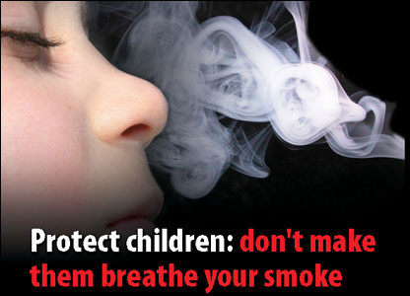

Slide 39
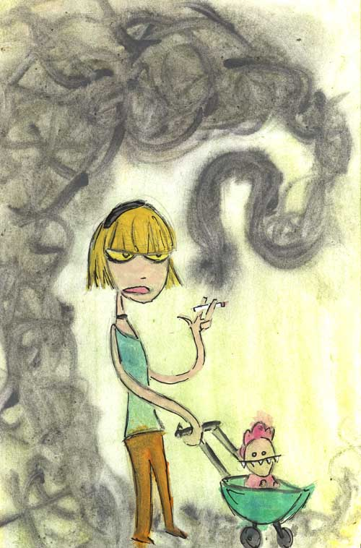

Slide 40
EFFECTS OF SMOKE ON NONSMOKERS
Tobacco smoke contains more than 4,000 different chemical compounds, 43 of which are identified as carcinogens.
Causes eye irritations, headaches, ear infections, and coughing.
3,000 people ever year are diagnosed with lung cancer caused by secondhand smoke.

Slide 41
EFFECTS OF SMOKE ON YOUNG CHILDREN
Children of smokers tend to have higher incidence of sore throats, ear infections, and upper respiratory problems
Children who live with smokers have double the risk of developing lung cancer
Children learn by example, they are 3 times as likely to smoke

