Slide 1
Managing Weight and Body Composition

Slide 2
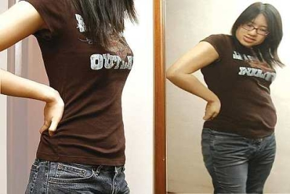
Body Image
The way you see your body

Slide 5
Body Mass Index
(BMI) – a ratio that allows you to assess your body size in relation to your height and weight

Slide 7
Body Composition
Overweight – a condition in which a person is heavier than the standard weight range for his / her height
Obesity – having an excess amount of body fat
Underweight – a condition in which a person is less than the standard weight range for his / her height

Slide 8
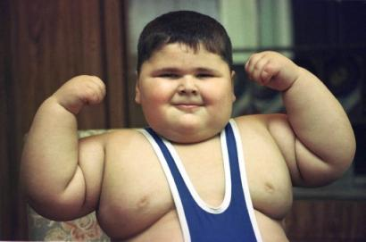

Slide 12
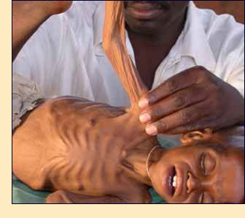

Slide 13
Weight- Loss Strategies
Eat 1,700 – 1,800 calories daily to meet your body’s energy needs
Include your favorites in moderation
Eat a variety of low-calorie, nutrient-dense foods
Drink plenty of water

Slide 14
Weight-Gain Strategies
Increase your calorie intake
Eat often and take second helpings
Eat nutritious snacks
Build muscle

Slide 15
Risky Weight-Loss Strategies
Fad Diets - weight-loss plans that are popular for only a short time
Liquid Diets
Fasting
Diet Pills

Slide 16
EATING DISORDERS
An extreme, harmful eating behavior that can cause serious illness or even death

Slide 18
Anorexia Nervosa
A disorder in which the irrational fear of becoming obese results in severe weight loss from self- imposed starvation

Slide 20
Bullimia Nervosa
A disorder in which some form of purging or clearing of the digestive system tract follows cycles of overeating

Slide 22
Binge Eating Disorder
A disorder characterized by compulsive overeating

