Slide 1
NUTRITION

Slide 2
Nutrition -
The process by which the body takes in and uses food

Slide 3
Calories –
Units of heat that measure the energy used by the body and the energy that foods supply to the body
Nutrients –
substances in the food that your body needs to grow, to repair itself, and to supply you with energy

Slide 4
DIET GOALSGLS
1- Eat a variety of foods
2- Maintain your ideal weight
3- Avoid too much fat and cholesterol
4- Eat foods with adequate starch
5- Avoid to much sugar
6- Avoid too much sodium
7- Avoid alcohol

Slide 5
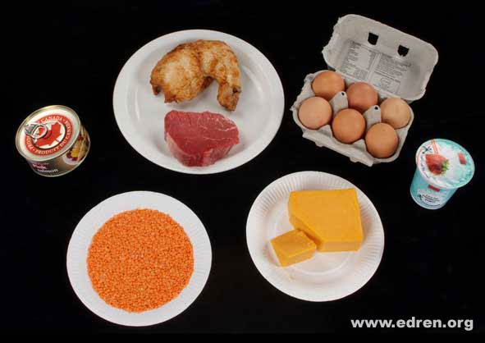
Types of Nutrients
Protein

Slide 6
Proteins
Supports growth of cells
Forms antibodies to fight illness

Slide 7
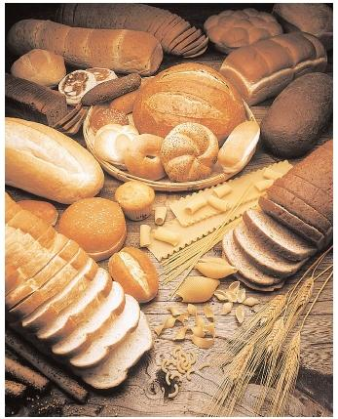
Carbohydrates

Slide 8
Carbohydrates
Major source of energy
Supplies fiber for the body

Slide 9
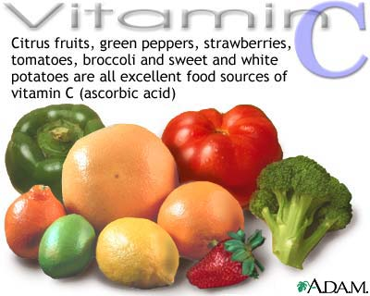
Vitamin C

Slide 10
Vitamin C
Holds cells together
Strengthens blood vessels
Resists infections
Helps body use iron

Slide 11
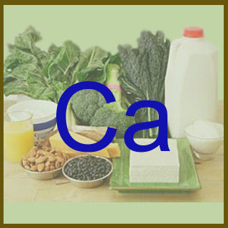
Calcium

Slide 12
Calcium
Strengthens teeth and bones
Helps blood clot
Helps muscles contract and relax
Helps nerves send signals

Slide 13
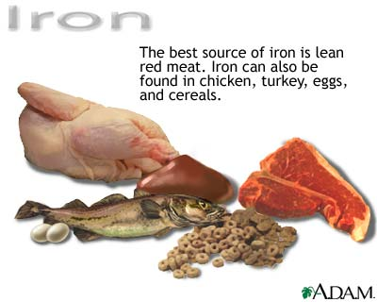
Iron

Slide 14
Iron
Helps body use energy
Forms part of red blood cells

Slide 15
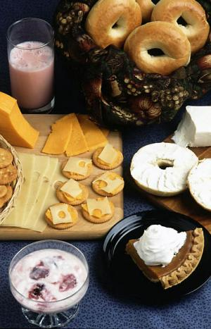
Fats

Slide 16
Fats
Supplies fatty acids
Part of every cell

Slide 17
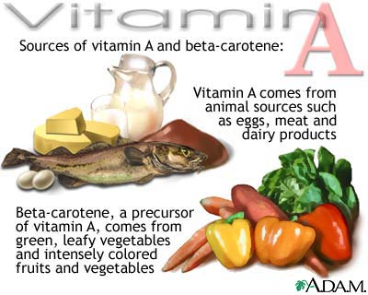
Vitamin A

Slide 18
Vitamin A
Helps form skin and mucous membranes
Helps eyesight

Slide 19
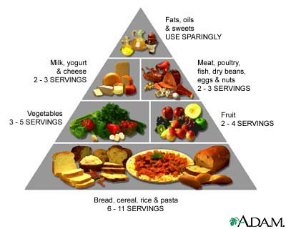
FOOD GUIDE PYRAMID

Slide 20
How To Avoid To Much Sugar
* Eat less of foods containing sugars
Examples: candy, soft drinks, ice cream, cookies, and cakes
*Select fresh fruits canned without sugar or with light sugar
*Read food labels for sugar content
*Remember how much and how often you eat sugar

Slide 21
Avoiding Sugar
Americans eat more than 59 kilograms of sugars and sweeteners in a year
Sugar has many names: glucose, fructose, sucrose, maltose, lactose, and syrup
Major health hazard from eating too much sugar is TOOTH DECAY

Slide 22
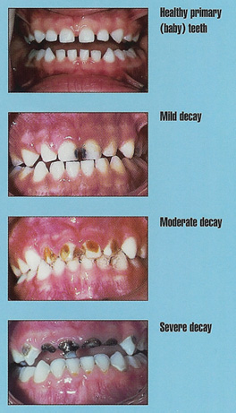

Slide 23
Ways to avoid to much sodium
Cook with only small amounts of table salt
Add little or no salt to food at the table
Limit intake of salty foods : potato chips, pretzels, popcorn, cheese, pickled foods, and cured meats
Read food labels

Slide 24
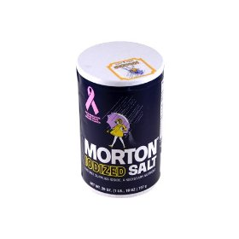

Slide 25
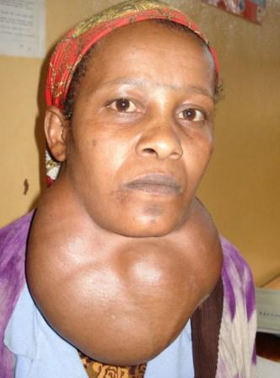

Slide 26
CALORIES
Calories – a measure of the amount of energy in food
Number of calories you need depends on your : age, gender, body build, and physical activity
Girls = 2400 Boys = 2800

Slide 27
Weight Gain – when food you eat contains more calories than your body needs for energy, the extra energy must be used in some way. It is then stored as fat in the body
Weight Loss – when the food you eat does not contain enough calories to give your body energy it needs, you then use stored fat for energy

