Slide 1
Physical Fitness

Slide 2
Physical Activity
Any form of movement that causes your body to use energy

Slide 3
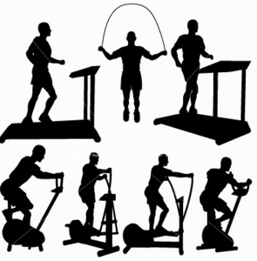

Slide 4
Why Exercise?
Cardiovascular Endurance

Slide 5
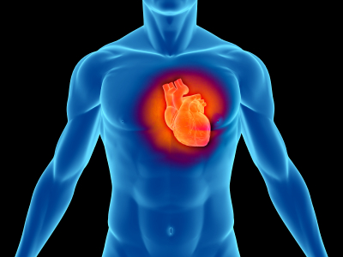

Slide 6
Stress Management
Feeling of Accomplishment

Slide 7


Slide 8
Weight control
Immune system

Slide 9
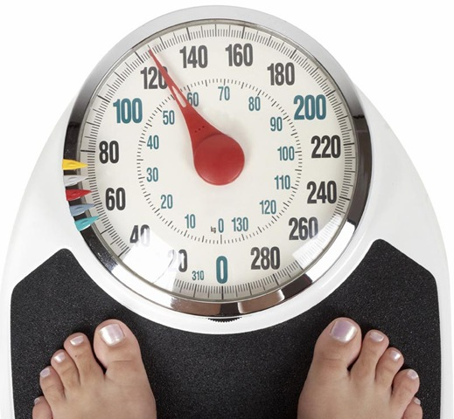

Slide 10
Sedentary Lifestyle
A way of life that involves little physical activity

Slide 11


Slide 12


Slide 13
Metabolism
The process by which your body gets energy from food

Slide 14
Elements of Fitness
1- Cardio-respiratory endurance: the ability of the heart, lungs, and blood vessels to utilize and send fuel and oxygen to the body’s tissues during long periods of moderate-to-vigorous activity
2- Muscular Strength: the amount of force a muscle can exert
3- Muscular Endurance: the ability of the muscles to perform physical tasks over a period of time without becoming fatigued

Slide 15
4- Flexibility: the ability to move a body part through a full range of motion
5- Body Composition: the ratio of body fat to lean body tissue, including muscle, bone, water, and connective tissue such as ligaments, cartilage, and tendons

Slide 16
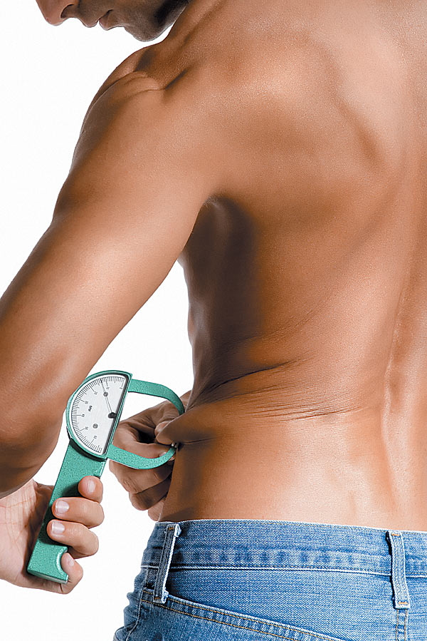

Slide 17
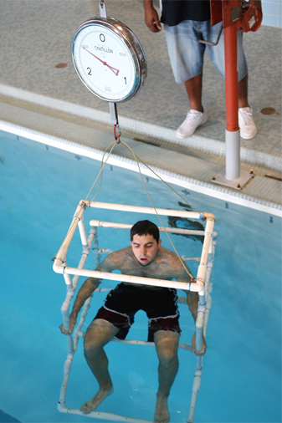

Slide 18
Aerobic exercise
Any activity that uses large muscle groups, is rhythmic in nature, and can be maintained continuously for at least 30 minutes three times a day .

Slide 19
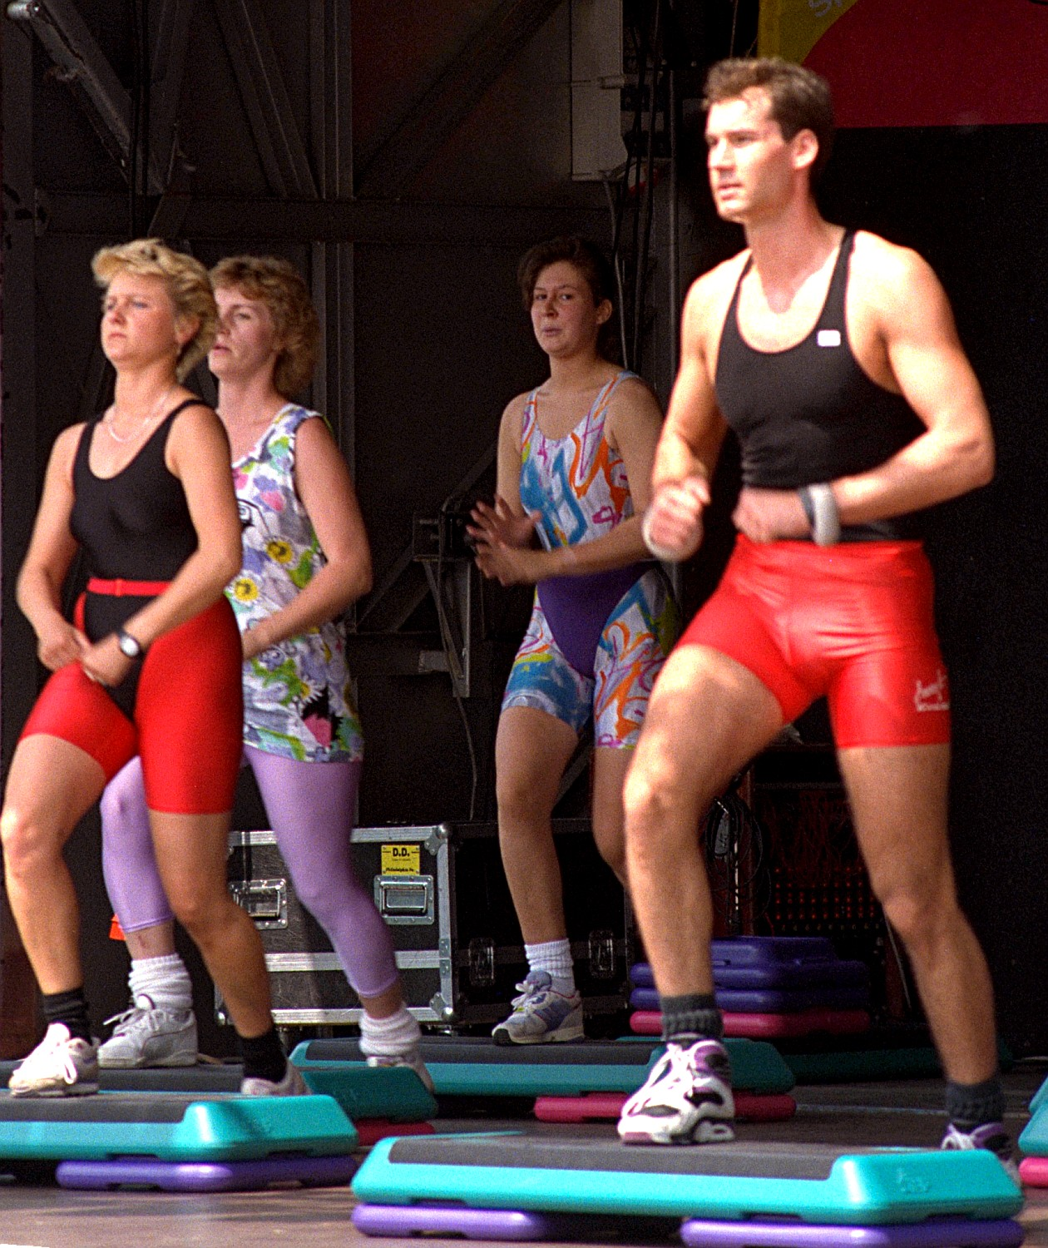

Slide 20
Anaerobic Exercise
Intense short bursts of activity in which the muscles work so hard that they produce energy without using oxygen.

Slide 21
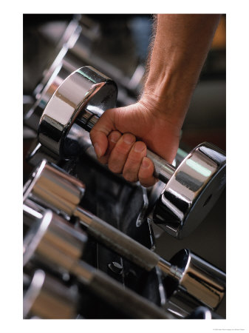

Slide 22
Effective Fitness Programs based on three principles:
1- Overload: working the body harder than it is normally worked
2- Progression: the gradual increase in overload necessary to achieve higher levels of fitness
3- Specificity: particular exercises and activities improve particular areas of health-related fitness

Slide 23
Three stages of an exercise program
1- The Warm-up: An activity that prepares the muscles for work
2- The Workout: part of an exercise program when the activity is performed at its highest peak
3- The Cool-Down: activity that prepares the muscles to return to a resting state

Slide 24
What is the F.I.T.T. Formula
F- FREQUENCY
I- INTENSITY
T- TIME/DURATION
T- TYPE

Slide 25
Heart Rate
Number of times the heart contracts per minute

Slide 26
Stroke Volume
Amount of blood pumped from the left ventricle each time the heart contracts

Slide 27
Target Heart Rate
Intensity at which the heart needs to work for aerobic and CVE fitness

Slide 28
RHR (resting heart rate)
    Number of times your heart contracts each minute while the body is at rest

Slide 29
MHR (maximal heart rate)
    Maximal heart rate the body is capable of attaining. Estimated by subtracting your age from 220.

Slide 30
Training Program
A program of formalized physical preparation for involvement in a sport or another physical activity

Slide 31
Hydration –
    Taking in fluids so that the body functions properly

Slide 32
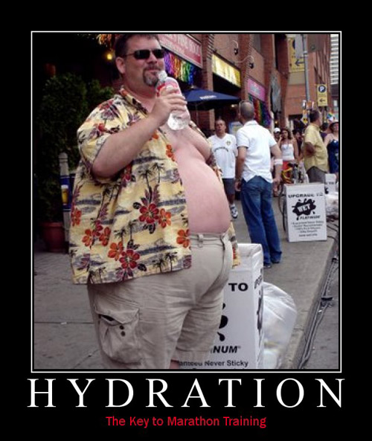

Slide 33
Anabolic Steroids –
    Synthetic substances that are similar to the male hormone testosterone

Slide 34
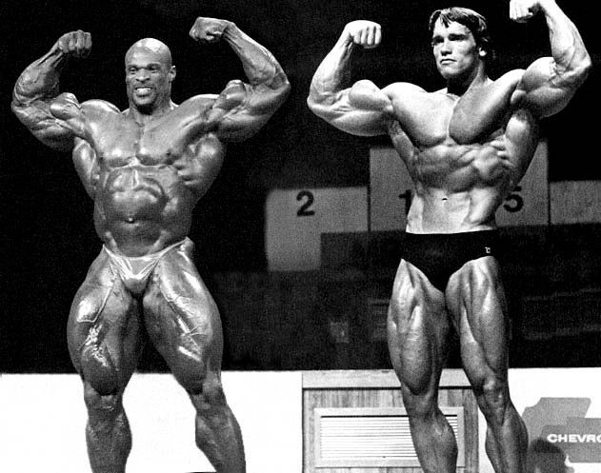

Slide 35
Weather Related Risks while being Physically Active
Overexertion – over working the body
Heat Cramp – muscle spasms that result from a loss of large amounts of salt and water through sweating
Heatstroke – a condition in which the body loses the ability to rid itself of excessive heat through perspiration
Frostbite – a condition that results when body tissues become frozen

Slide 36
Hypothermia – a condition in which body temperature becomes dangerously low

