Slide 1
NONCOMMUNICABLE DISEASES AND DISABILITIES

Slide 2
NONCOMMUNICABLE DISEASE
A disease that is not transmitted by another person, a vector, or the environment
Example: heart disease, cancer

Slide 3
CARDIOVASCULAR DISEASE (CVD)
A disease that affects the heart or blood vessels

Slide 4
HYPERTENSION
High blood pressure
Normal blood pressure is 120/80
ARTHEROSCLEROSIS
The process in which plaques accumulate on artery walls
Usually because of high intake of saturated fats and cholesterol
Heart attack or stroke may result

Slide 5
DIAGNOSTIC TOOLS FOR CVD:
EKG
Electrocardiogram produces a graph of the electrical activity of the heart
Shows heart function
MRI
Magnetic resonance imaging uses powerful magnets to produce images of internal body organs
Images used to identify heart damage and defects

Slide 6
RADIONUCLIDE IMAGING
Radionuclides injected into the blood can be observed on a computer screen as they pass through the heart
Used to assess the heart’s blood supply and to show heart function
ANGIOGRAPHY
A thin, flexible tube is guided through blood vessels to the heart
Dye injected and motion X rays are taken to look at heart obstructions

Slide 7
TREATMENT OPTIONS FOR CVD:
CORONARY BYPASS
A healthy vein is removed from the leg or chest and placed elsewhere to create a detour around a blocked artery
ANGIOPLASTY
A tube with a balloon is inserted into a blocked artery
The balloon is inflated against the artery walls. A metal structure may remain to keep the artery open

Slide 8
MEDICATIONS
A variety of medications are used to treat CVDs
Include diuretics to aid with the body’s fluid balance, cholesterol-lowering drugs, and drugs that slow the blood’s clotting mechanisms in order to reduce the risk of stroke
PACEMAKER
Used to treat an irregular heartbeat
The small device sends steady electrical impulses to the heart to make it beat regularly

Slide 9
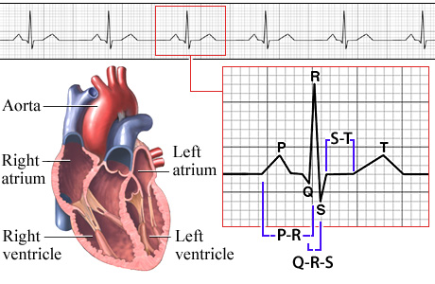
EKG

Slide 10
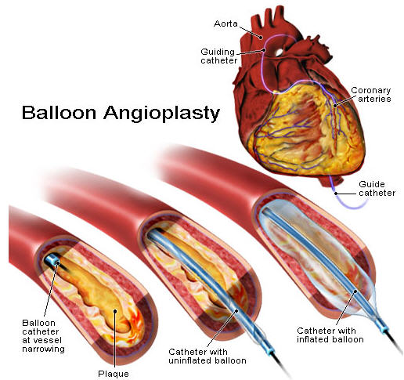

Slide 11
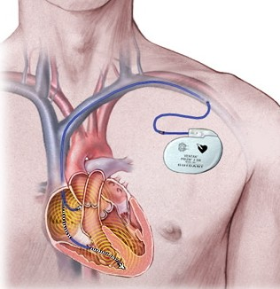
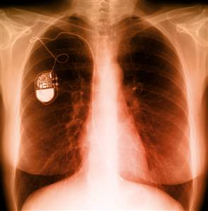
PACEMAKER

Slide 12
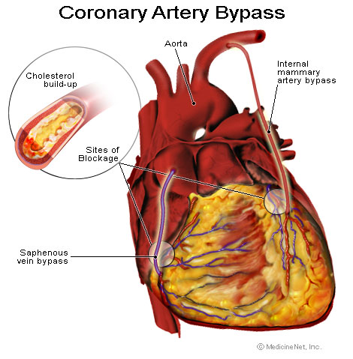
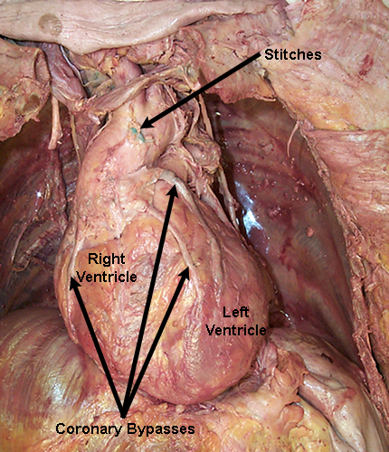

Slide 13
ANGINA PECTORIS
Chest pain that results when the heart does not get enough oxygen
Pain that usually last a few seconds
Can be treated with medication

Slide 14
HEART ATTACK
Damage to the heart muscle caused by a reduced or blocked blood supply
Most heart attacks start slowly with mild pain or discomfort, which is often mistaken for indigestion

Slide 15
CONGESTIVE HEART FAILURE
The heart gradually weakens to the point that cannot maintain regular pumping rate and force
Can be a result of high blood pressure, atherosclerosis, a heart valve defect, or other factors
Can be managed with meds, good nutrition, physical activity

Slide 16
STROKE
When arterial blockage interrupts the flow of blood to the brain
Affects different parts of the body, depending on which part of the brain is deprived of oxygen

Slide 17
RISK FACTORS FOR CVDS YOU CAN CONTROL:
Tobacco use
High blood pressure
High cholesterol
Physical inactivity
Excess weight
Stress
Drug and alcohol use

Slide 18
RISK FACTORS FOR CVDS THAT YOU CANNOT CONTROL
Heredity
Gender
Age

Slide 19
CANCER
Uncontrollable growth of abnormal cells

Slide 20
TUMOR
An abnormal mass of tissue that has no natural role in the body
Benign
Noncancerous
Malignant
Cancerous, spread to neighboring tissues and through the body or lymph to other parts of the body
Metastasis
The spread of cancer from the point where it originated to other parts of the body

Slide 21
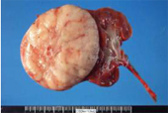
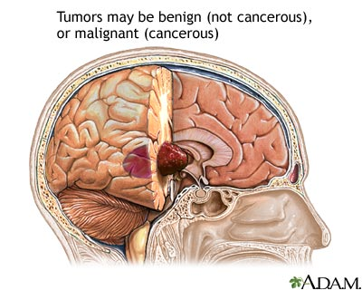
TUMORS

Slide 22
TYPES OF CANCER
Lymphomas
Cancers of the immune system
Leukemias
Cancers of the blood-forming organs
Carcinomas
Cancers of glands and body linings, including the skin and the lining of the digestive track and lungs
Sarcomas
Cancers of connective tissue, including bones, ligaments, and muscle

Slide 23
MOST COMMON ORGANS AFFECTED:
Skin
Breast
Prostate
Lung
Colon/rectum
Mouth
Cervix
Testicle

Slide 24
BIOPSY
THE REMOVAL OF A SMALL PIECE OF TISSUE FOR EXAMINATION
Usually necessary to determine whether cancer is present

Slide 25
TREATING CANCER
SURGERY
Removes some or all of the cancerous masses from the body
RADIATION THERAPY
Aims rays from radioactive substances at cancerous cells
Radiation kills the cells and shrinks the cancerous mass
CHEMOTHERAPY
Uses chemicals to destroy cancer cells

Slide 26
IMMUNOTHERAPY
Activates a person’s immune system to recognize specific cancers and destroy them
HORMONE THERAPY
Involves using medicines that interfere with the production of hormones

Slide 27
REMISSION
A period of time when symptoms disappear
Not always cured, it can recur years later

Slide 28
ALLERGY
A specific reaction of the immune system to a foreign and frequently harmless substance

Slide 29
HISTAMINES
Chemicals that can stimulate mucus and fluid production in an area
They produce the sneezing, itchy eyes, runny nose, and other symptoms that make a person with allergies uncomfortable

Slide 30
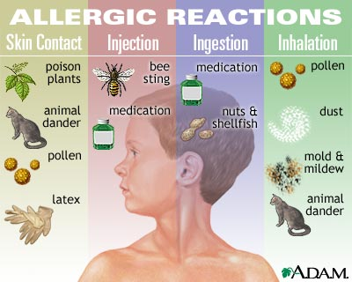
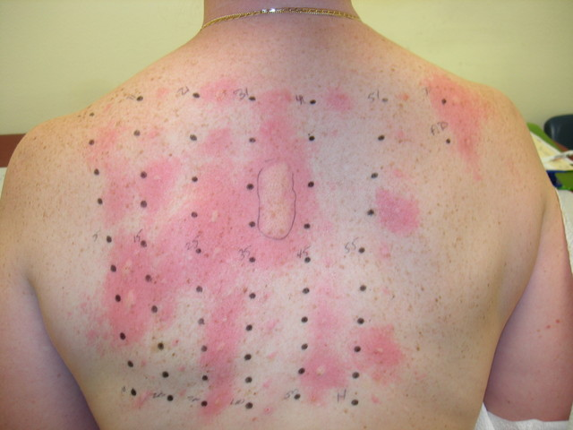

Slide 31
ASTHMA
An inflammatory condition in which the small airway in the lungs become narrowed, causing difficulty in breathing

Slide 32
MANAGING ASTHMA
Monitor the condition
Recognize the warning signs
Manage the environment
Reduce asthma triggers in the environment
Manage stress
Relaxation and stress management
Take medication
Can be used to relieve symptoms, prevent flare-ups, and make air passages less sensitive to asthma triggers

Slide 33
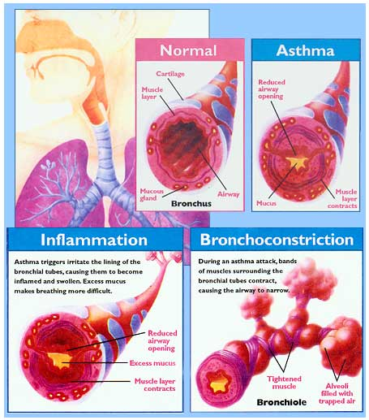

Slide 34
DIABETES
A chronic disease that affects the way body cells convert food into energy

Slide 35
TYPE 1
Body does not produce insulin, and glucose builds up in the blood, starving cells of the energy they need
Must take daily doses of insulin, either through injections or through a special pump that is attached to the body by tubing that is surgically implanted
Able to live normal lives

Slide 36
TYPE 2
The body is unable to make enough insulin or to use insulin properly
Individuals must carefully monitor their diet to control their blood sugar levels
Oral medications or injections of insulin are required
Becoming increasingly found in children

Slide 37
ARTHRITIS
A group of more than 100 different diseases that cause pain and loss of movement in the joints

Slide 38
DISABILITY
Any physical or mental impairment that limits normal activities, including seeing, hearing, walking, or speaking

Slide 39
COMMON CAUSES OF BLINDNESS
Diabetes
Leading cause of blindness
Macular degeneration
Disease in which the retina degenerates
Glaucoma
Disease that damages the optic nerve of the eye
Cataracts
A clouding of the lens of the eye

Slide 40
PROFOUND DEAFNESS
A hearing loss so severe that a person affected cannot benefit from mechanical amplification, such as a hearing aid

Slide 41
MENTAL RETARDATION
The below-average intellectual ability present from birth or early childhood and associated with difficulties in learning and social adaptation
Factors that cause mental retardation:
Genetic factors- example: Down syndrome
Fetal alcohol syndrome

Slide 42
AMERICANS WITH DISABILITIES ACT
A law prohibiting discrimination against people with physical or mental disabilities in the workplace, transportation, public accommodations, and telecommunications

