Slide 1
FOUNDATIONS OF HEALTHY RELATIONSHIPS

Slide 2
RELATIONSHIPS
A bond or connection you have with other people
HEALTHY RELATIONSHIPS
Family relationships
Friendships
Community relationships
Citizenship- the way you conduct yourself as a member of the community

Slide 3
THE THREE C’s OF HEALTHY RELATIONSHIPS
COMMUNICATION
Your ways of sending and receiving messages
COOPERATION
Working together for the good of all
COMPROMISE
A problem-solving method that involves each participant’s giving up something to reach a solution that satisfies everyone

Slide 4
Characteristics of healthy relationships
Mutual respect and consideration
Honesty
Dependability
Commitment

Slide 5
COMMUNICATION IS CRITICAL TO HEALTHY RELATIONSHIPS
COMMUNICATION SYLES
Passive-
Involves the inability or unwillingness to express thoughts and feelings
Aggressive-
Try to get their way through bullying and intimidation
Assertive-
Involves expressing thoughts and feelings clearly and directly but without hurting others

Slide 6
ACTIVE LISTENING
Paying close attention to what someone is saying and communicating

Slide 7
TECHNIQUES FOR ACTIVE LISTENING
1- Reflective listening-
You rephrase or summarize what the other person said
2- Clarifying-
Involves asking the speaker what he/she thinks or feels about the situation being discussed
3- Encouraging-
You encourage the speaker when you signal that you are interested and involved
4- Empathizing-
You are able to imagine and understand how someone else feels

Slide 8
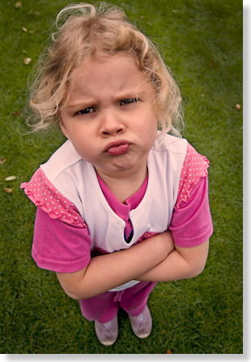
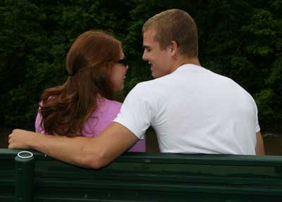
BODY LANGUAGE
Nonverbal communication through gestures, facial expressions, behaviors, and posture

Slide 9
5 EXAMPLES TO ELIMINATING COMMUNICATION BARRIERS
Image and identify issues-
Know who you are
Unrealistic expectations-
Avoid imposing unrealistic expectations on your listener
Lack of trust-
If you don’t trust, don’t tell
Prejudice-
Prevents a person from having an open mind
Gender stereotyping-
Don’t assume an exaggerated belief about people of a certain gender (ex: all males like sports, all females like to cook)

Slide 10
CONSTRUCTIVE CRITICISM
Non-hostile comments that point out problems for the purpose of helping a person improve
EXAMPLE: “I really don’t like missing the opening scene of a movie. Let’s get here early next time, okay?”

Slide 11
RESOLVING CONFLICT
CONFLICT-
Any disagreement, struggle, or fight
INTERPERSONAL CONFLICT-
Disagreements between groups of any size, from two people to entire nations

Slide 12
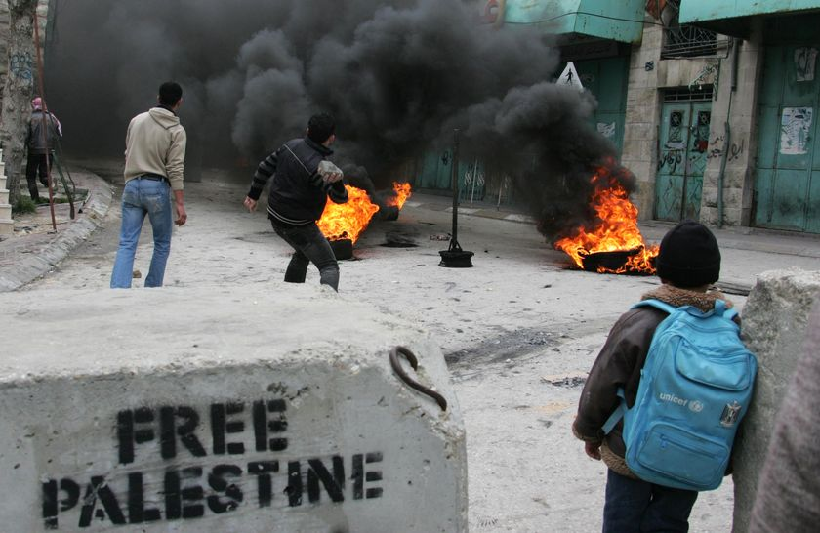

Slide 14
COMMON CAUSES OF CONFLICTS:
POWER STRUGGLES
LOYALTY
JEALOUSY/ENVY
PROPERTY DISPUTES
TERRITORY AND SPACE

Slide 15
CONFLICT RESOLUTION
The process of solving a disagreement in a manner that satisfies everyone involved
1. take time to calm down and think over the situation
2. when discussing the conflict, take turns explaining each person’s side of the conflict without interruption
3. ask for clarification so that each person understands the other’s position
4. brainstorm solutions
5. agree on a solution that benefits both sides
6. follow up to see whether the correct solution was chosen and whether that solution worked for each person

Slide 16
NEGOTIATION
The use of communication and often compromise to settle a disagreement
STEPS TO TAKE WHEN NEGOTIATING
1. Select a time and place suited to working out problems
2. Work together toward a solution
3. Keep an open mind
4. Be flexible
5. Take responsibility for your role in the conflict
6. Give the other person an “out”

Slide 17
MEDIATION-
A process in which specially trained people help others resolve their conflicts
CONFIDENTIALITY-
Respecting the privacy of both parties and keeping details secret
PEER MEDIATORS-
Students trained to help other students find fair resolutions to conflicts and disagreements

