Slide 1
Mental / Emotional Problems

Slide 2
Managing Stress
Identifying Personal Causes Of Stress
LIFE EVENTS
PHYSICAL STRESSORS
DAILY HASSELS

Slide 3
STRESS MANAGEMENT SKILLS
Skills that help an individual handle stress in a healthful, effective way
Techniques:
Redirect your energy
Relax and laugh
Keep a positive outlook
Seek out support

Slide 4
Anxiety
the condition of feeling uneasy or worried about what may happen

Slide 5
Depression
A prolonged feeling of helplessness, hopelessness, and sadness

Slide 7
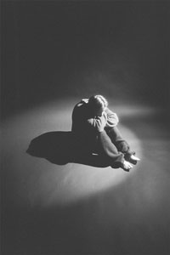

Slide 8
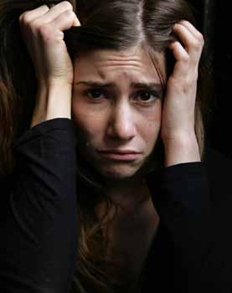
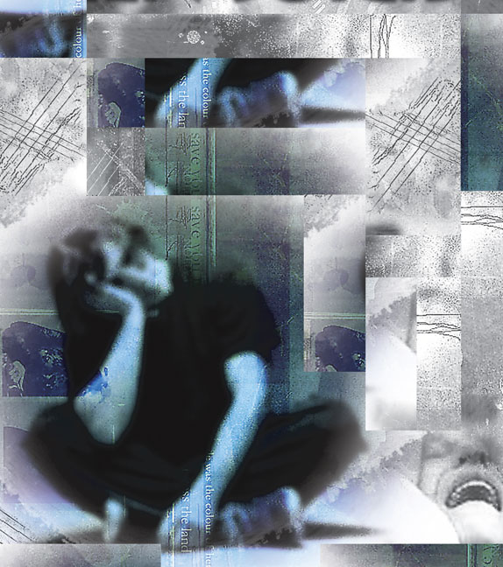

Slide 9
Resiliency
The ability to adapt effectively and recover from disappointment, difficulty, or crisis

Slide 10
Mental Disorders
An illness of the mind that can affect the thoughts, feelings, and behaviors of a person, preventing him / her from leading a happy, healthful, and productive life

Slide 11
Types of Mental Disorders
Anxiety Disorders
Phobia
Obsessive-Compulsive Disorder
Panic Disorder
Post-Traumatic Stress Disorder

Slide 12
Mood Disorders
Clinical Depression
Bipolar Disorder

Slide 14
Conduct Disorders
Schizophrenia
Personality Disorders

Slide 15
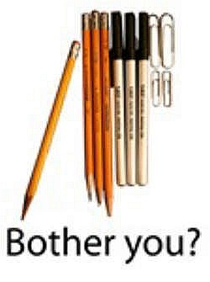

Slide 16
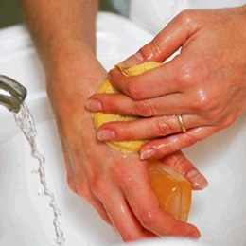

Slide 17
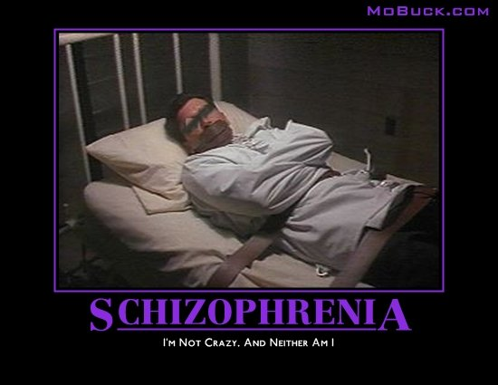

Slide 18
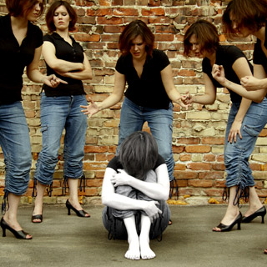

Slide 19
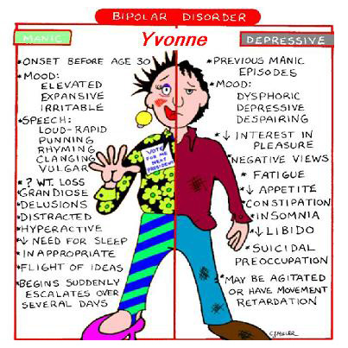

Slide 20
Suicide
The act of intentionally taking one’s own life

Slide 21
Recognizing the warning signs
Direct statements
Indirect statements
Substance abuse
Withdrawal from friends
Unusual obsession with death
Persistent boredom and indifference
Impulsive, irrational, or bizarre behavior
Overwhelming sense of guilt, shame, or rejection

Slide 22
How can you help others??
Initiate a meaningful conversation
Show support and ask questions
Try to persuade the person to seek help

Slide 23
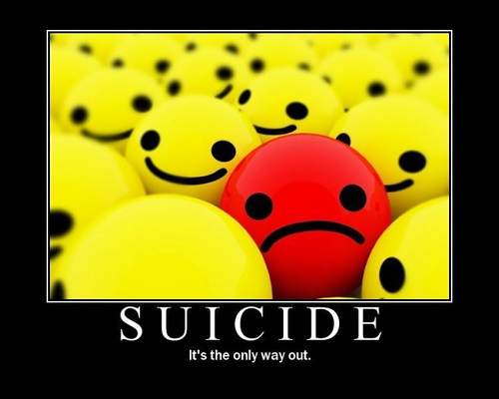

Slide 24
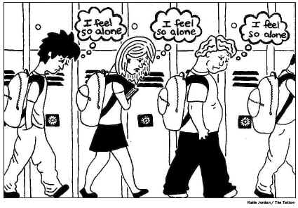

Slide 25
Therapy Methods for Treatment of Mental or Emotional Problems
Psychotherapy- an ongoing dialogue between a patient and a mental health professional
Behavior therapy- treatment process that focuses on changing unwanted behaviors through rewards and reinforcements
Cognitive therapy- treatment method designed to identify and correct distorted thinking patterns that can lead to feelings and behaviors that may be troublesome, self-defeating, or self-destructive

Slide 26
Group therapy- treating a group of people who have similar problems and who meet regularly with a trained counselor
Biomedical therapy- the use of certain medications to treat or reduce the symptoms of a mental disorder

Slide 27
Understanding Death and Grief
Coping
Dealing successfully with difficult changes in your life

Slide 28
Grief Response
An individual’s total response to a major loss

Slide 29
The Grieving Process
1- Denial or Numbness
2- Emotional Releases
3- Anger
4- Bargaining
5- Depression
6- Remorse
7- Acceptance
8- Hope

