Slide 1
MENTAL / EMOTIONAL HEALTH

Slide 2
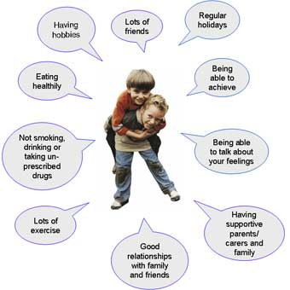
Mental / Emotional Health
The ability to accept yourself and others, adapt to and manage emotions, and deal with the demands and challenges you meet in life.

Slide 3
Characteristics of Good Mental / Emotional Health
Positive Self-Esteem
Sense of Belonging
Sense of Purpose
Positive Outlook
Autonomy

Slide 4
Hierarchy of Needs
Level 1- Physical – need to satisfy basic needs of hunger, thirst, sleep, and shelter
Level 2- Safety- need to be secure from danger
Level 3- Belonging- need to love and be loved, need to belong
Level4- Feeling Recognized- Need to achieve, need to be recognized
Level 5- Reaching Potential- need for self- actualization

Slide 5
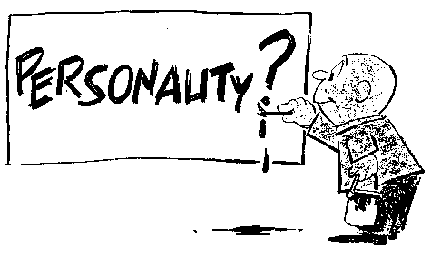
Personality
A complex set of characteristics that makes you unique

Slide 6
Your Personal Identity
Your interests
Your likes and dislikes
Your talents and abilities
Your values and beliefs
Your goals

Slide 7
Developmental Assests
the building blocks of development that help young people grow up as healthy, caring, and responsible individuals

Slide 8
Constructive Criticism
Non-hostile comments that point out problems and encourage improvement

Slide 9
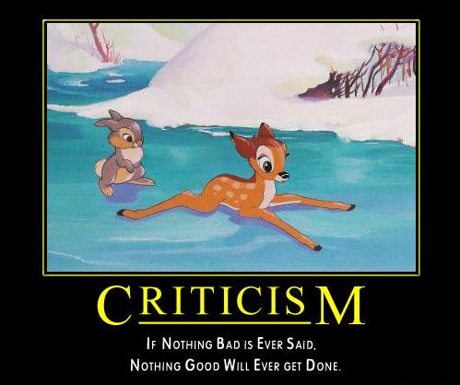

Slide 10
Emotions-
Signals that tell your mind and body how to react

Slide 11
Hormone-
A chemical secreted by your glands that regulates the activities of different body cells

Slide 12
Empathy-
The ability to imagine and understand how someone else feels

Slide 13
Hostility-
The intentional use of unfriendly or offensive behavior

Slide 14
Managing Difficult Emotions
Defense Mechanisms- mental processes that protect individuals from strong or stressful emotions and situations
Suppression- holding back or restraining

Slide 15
STRESS
The reaction of the body and mind to everyday challenges and demands

Slide 16
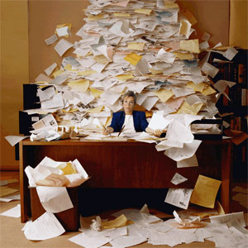

Slide 18
WHAT CAUSES STRESS??
Biological stressors- illness, disabilities, or injuries
Environmental stressors- poverty, pollution, crowding, noise, or natural disasters
Cognitive / thinking stressors-the way you perceive a situation or how it affects you and the world around you
Personal behavior stressors- negative reactions in the body and mind caused by using tobacco, alcohol, or other drugs or lack of physical activity
Life situation stressors- the death of a pet, the separation or divorce of parents, or having trouble in relationships with peers

Slide 19
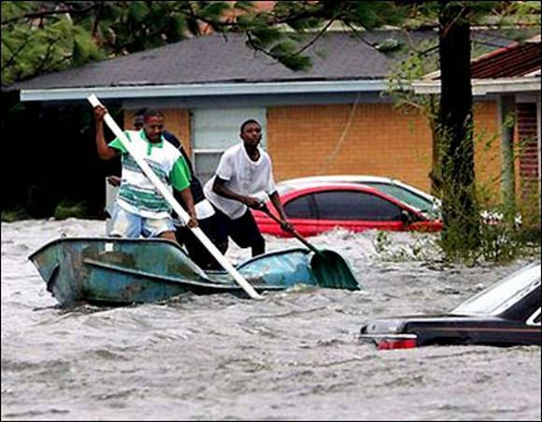

Slide 20
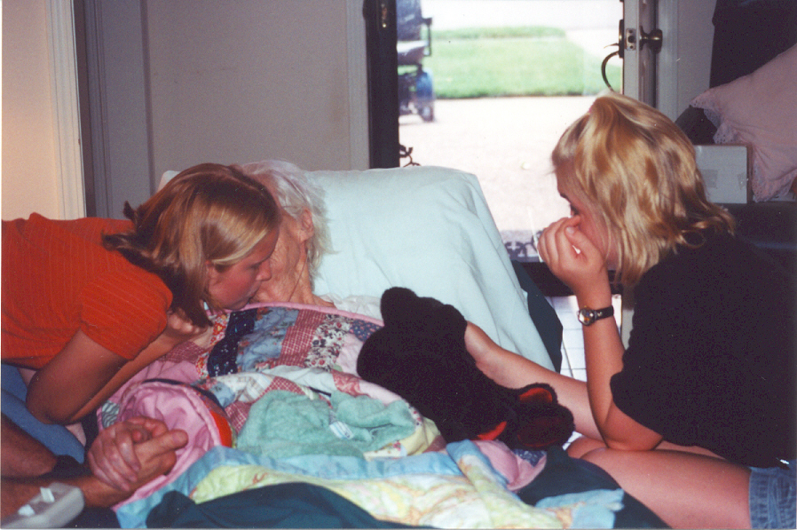

Slide 21
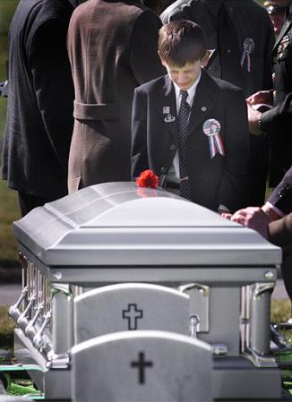

Slide 22
What’s the Body’s Stress Response??
Alarm- body and mind go on high alert
Resistance- body adapts to the rush created by alarm, and reacts to the stressor
Fatigue- a tired feeling takes over that lowers your level of activity

Slide 23
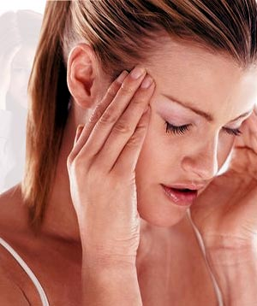
Physical Effects of Stress
HEADACHE

Slide 24
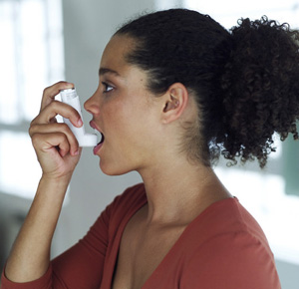
ASTHMA

Slide 25
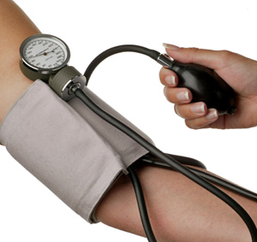
HIGH BLOOD PRESSURE

Slide 26
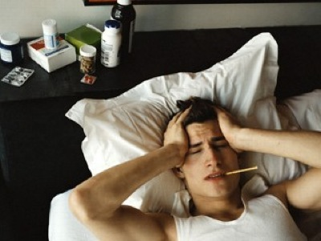
WEAKENED IMMUNE SYSTEM

Slide 27
Mental / Emotional and Social effects of stress
DIFFICULTY CONCENTRATING
MOOD SWINGS
RISKS OF SUBSTANCE ABUSE

Slide 28
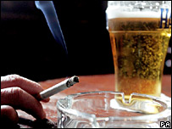

Slide 29
How can you take control of chronic stress??
Engage in physical activity
Look for support among your friends and family
Find a hobby or activity that relaxes you
Avoid using tobacco, alcohol, and other drugs

