Slide 1
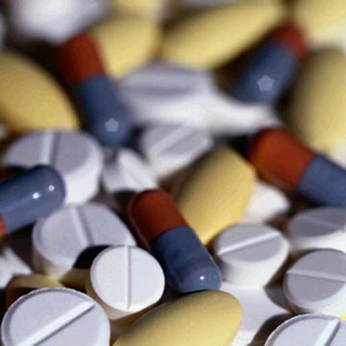
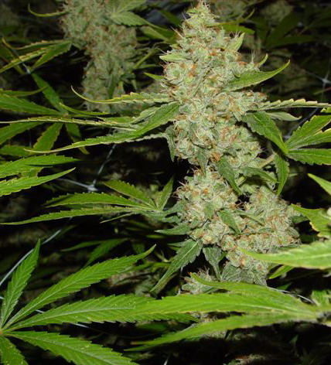
Medicines and Drugs

Slide 2
MEDICINE:
Drugs that are used to treat or prevent disease or other conditions

Slide 3
DRUGS:
Substances other than food that change the structure or function of the body or mind

Slide 4
MEDICINES CAN BE SORTED INTO FOUR BROAD CATEGORIES:
1- Medicines that help prevent disease
2- Medicines that fight pathogens, or infectious agents that cause disease
3- Medicines that relieve pain
4- Medicines that help maintain and restore health and regulate the body’s systems

Slide 5
MEDICINES THAT PREVENT DISEASE
Vaccines-
a preparation introduced into the body to stimulate an immune response
Antibodies are produced to give your body long lasting protection
Antitoxins-
extracts of blood fluids that contain antibodies and act more quickly than vaccines
Injections of antitoxins neutralize the effect of toxins

Slide 6
MEDICINES THAT PROMOTE HEALTH:
Allergy medicines
Antihistamines
Body regulating medicines
Regulate blood pressure, inhalers, insulin
Antidepressant and antipsychotic medicines
Mood stabilizers (depression, bipolar)
Cancer treatment medicines
chemotherapy

Slide 7
SIDE EFFECTS
Reactions to medicine other than the one intended

Slide 8
OTHER PROBLEMS:
Tolerance-
a condition in which the body becomes used to the effect of a medicine
Withdrawal-
occurs when a person stops using a medicine on which he or she has a chemical dependence

Slide 9
Withdrawal Symptoms: Insomnia, headaches, vomiting, chills, and cramps

Slide 10
MEDICINE SAFETY
The federal government has established laws and policies for testing and approving new medicines
All medicines must meet standards set by the FDA before being approved and made available for sale
The FDA requires manufacturers to supply information about the medicine’s chemical composition, intended use, effects, and possible side effects

Slide 11
Prescription Medicines-
must have written approval of a licensed physician
Over-the-counter Medicines-
medicines that you can buy without a prescription

Slide 12
PRESCRIPTION MEDICINE LABELS
Name of prescribing doctor
Name of patient
Directions from doctor
Name of medicine
Date prescription was filled
Strength
Expiration date
Number of pills
Number of refills

Slide 13
Prescription number
Pharmacy name, address, and phone number

Slide 14
MEDICINE MISUSE
Giving a prescription medicine to a person for whom it was not prescribed or taking another person’s medicine
Taking too much or too little of a medicine or taking a medicine for a longer or shorter period than prescribed
Discontinuing use of a medicine without informing the health care professional
Mixing medicines

Slide 15
FAMOUS PEOPLE WHO DIED FROM PERSCRIPTION MEDICATIONS
BRITTANY MURPHY
actress

Slide 16
ELVIS PRESLEY
Singer/Actor

Slide 17
MARILYN MONROE
actress

Slide 18
ANNA NICOLE SMITH
model

Slide 19
HEATH LEDGER
actor

Slide 20
MICHAEL JACKSON
singer

Slide 21
SUBSTANCE ABUSE- any unnecessary or improper use of chemical substances for nonmedical purposes
ILLEGAL DRUGS- chemical substances that people of any age may not lawfully manufacture, possess, buy, or sell
ILLICIT DRUG USE- the use or sale of any substance that is illegal or otherwise not permitted

Slide 26
FACTORS THAT INFLUENCE DECISIONS ABOUT DRUGS:
Peer pressure
Family members
Role models
Media messages
Perception

Slide 27
THREE HEALTH RISKS OF DRUG USE
1- PHYSICAL HEALTH
Overdose- a strong, sometimes fatal reaction to taking a large amount of a drug
Some drug use involves injecting substances through a needle, which can increase the risk of contracting diseases such as hepatitis B and HIV.

Slide 28
FAMOUS PEOPLE WHO DIED FROM ILLEGAL DRUGS
DJ AM

Slide 29
JIM MORRISON
THE DOORS

Slide 30
JIMI HENDRIX
Singer/guitar player

Slide 31
CHRIS FARLEY
actor

Slide 32
KEN CAMINITI
Baseball player
1996 MVP American league

Slide 33
2- MENTAL HEALTH-
Drugs cloud reasoning and thinking and users lose control of their behavior

Slide 34
3- SOCIAL HEALTH
Substance abuse can have a negative effect on relationships with friends and family members.
Substance abuse is a major factor in many crimes, suicides, and unintentional injuries

Slide 36
PSYCHOLOGICAL DEPENDENCE-
A condition in which a person believes that a drug is needed in order to feel good or to function normally
PHYSIOLOGICAL DEPENDENCE-
A condition in which the user has a chemical need for the drug

Slide 37
ADDICITION-
A physiological or psychological dependence on a drug

Slide 38
CONSEQUENCES OF DRUG USE:
Consequences to the individual
Diseases
Legal consequences
Jail time
Consequences for family and friends
Decision affects everyone
Consequences for babies and children
Developing babies, diseases (HIV)
Costs to society
Crime and violence/ driving accidents

Slide 39
MARIJUANA, INHALENTS, AND STEROIDS
Marijuana-
A plant whose leaves, buds, and flowers are smoked for their intoxicating effects

Slide 40
The health risks of marijuana:
Hallucinations and paranoia
Impaired short-term memory, reaction time, concentration, and coordination
Bloodshot eyes
Heart and lung damage
Increased appetite, leading to weight gain
Females- increased testosterone levels and risk of infertility
Males- lowered sperm count and testosterone levels

Slide 41
INHALANTS-
Substances whose fumes are sniffed and inhaled to achieve a mind-altering effect

Slide 44
ANABOLIC-ANDROGENIC STERIODS-
Synthetic substances that are similar to the male sex hormone testosterone

Slide 49
PSYCHOACTIVE DRUGS
Chemicals that affect the central nervous system and alter activity in the brain
Stimulants, depressants, narcotics, and hallucinogens

Slide 50
STIMULANTS:
DRUGS THAT SPEED UP THE CENTRAL NERVOUS SYSTEM
Caffeine, nicotine, cocaine, crack

Slide 51
COCAINE-
A rapid-acting, highly addictive stimulant that interrupts normal functioning of the central nervous systems
Experience euphoria, a feeling of intense well-being or elation.

Slide 52
CRACK-
Called rock or freebase rock

Slide 53
DEPRESSANTS:
Drugs that tend to slow down the central nervous system
Barbiturates, tranquilizers, ro-hypnol, GHB

Slide 54
BARBITURATES-
Drug that induces sleepiness
Results in mood changes, sleeping more than normal, and coma
Used illegally to produce a feeling of intoxication and to counteract the effects of stimulates

Slide 55
TRANQUILIZERS-
Depressants that reduce muscular activity, coordination, and attention span
Prescribed to relieve anxiety, muscle spasms, sleeplessness, and nervousness

Slide 56
NARCOTICS:
Specific drugs derived from the opium plant that are obtainable only by prescription and are used to relieve pain
Heroin, OxyContin, and morphine

Slide 57
HEROIN-
A highly addictive narcotic
Processed form of morphine that is injected, snorted, or smoked
Depresses the central nervous system and slows breathing and pulse rate

Slide 58
HALLUCINOGENS:
Drugs that alter moods, thoughts, and sense perceptions including vision, hearing, smell, and touch
PCP, LSD, and Ecstasy

Slide 59
PCP-
Considered one of the most dangerous of all drugs
Its effects vary greatly from user to user
Users report a distorted sense of time and space, increased muscle strength, and inability to feel pain
Flashbacks can occur at any time, causing panic, confusion, and lack of control

Slide 60
LSD-
An extremely strong hallucinogen
Increase the risk of convulsions, coma, heart and lung failure, and death
Affects the brain’s emotional center and distorts reality
May experience emotions ranging from extreme euphoria to panic to deep depression

Slide 61
DESIGNER DRUGS
Synthetic substances meant to imitate the effects of hallucinogens and other dangerous drugs
Can be several hundred times stronger than the drugs they are meant to imitate
Most recognized designer drug is ecstasy
ECSTASY – combination stimulant and hallucinogen

Slide 62
DRUG FREE SCHOOL ZONES-
Areas within 1,000 feet of schools and designated by signs, within which people caught selling drugs receive especially severe penalties

Slide 63
TYPES OF DRUG TREATMENT CENTERS
Outpatient drug-free treatment
Consists of individual or group counseling
Short-term treatment
Include residential, medication, and outpatient therapies
Maintenance therapy
Intended for heroin addicts, includes medication therapy
Therapeutic communities
Residences for people with a long history of drug abuse (structured programs last from 6-12 months)

