Slide 1

Health/Wellness

Slide 2
What is Health?
The combination of physical, mental/emotional, and social well-being.
THE HEALTH CONTINUUM:
  This continuum spans the complete spectrum of health from chronic disease and premature death to a high level of health

Slide 3
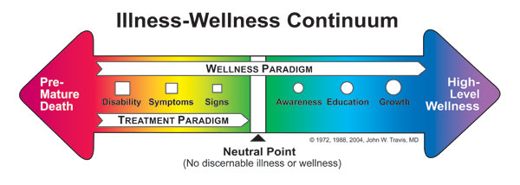
The continuum shows that your health can be measured on a sliding scale, with many degrees of health and wellness. Name three behaviors that would help you move toward the right side.

Slide 4
HOW DO YOU PROMOTE YOUR HEALTH??

Slide 5

Physical

Slide 6

Mental

Slide 7

Social

Slide 8
What is wellness?
An overall state of well-being, or total health.
Achieving wellness requires an ongoing, lifelong commitment to physical, mental/emotional, and social health.

Slide 9
LIFESTYLE FACTORS:
1- get 8-10 hours of sleep each night
2- healthy breakfast
3-physical activity for 20 mins a day, three or more day a week
4- maintain a healthy weight
5-avoid tobacco, alcohol, and other drugs
6-manage stress
7- maintain positive relationships
8-practice safe behaviors to prevent injuries

Slide 10
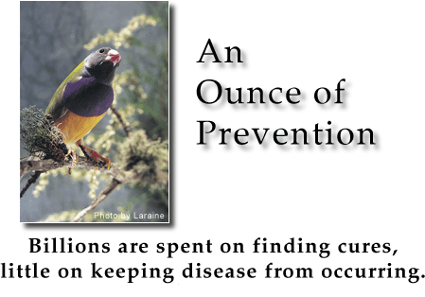
Key to wellness??
Prevention- practicing health and safety habits to remain free of disease and injury

Slide 11
HEALTH EDUCATION
The providing of accurate health information to help people make healthy choices

Slide 12
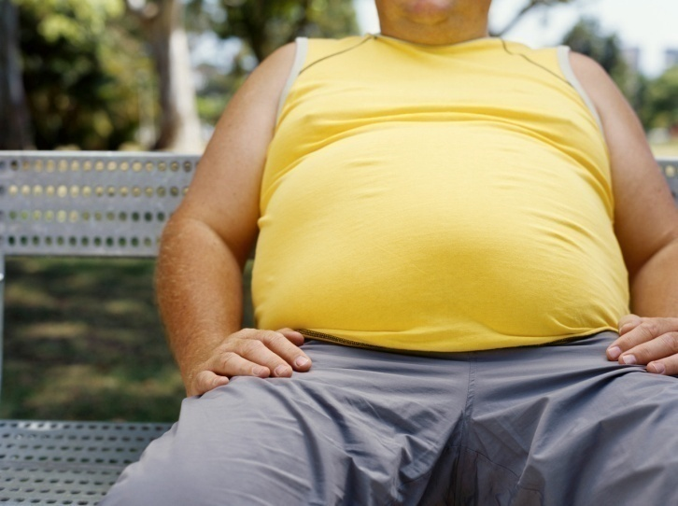
Your Health Habits ??

Slide 13
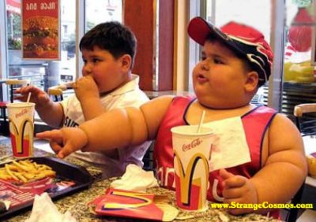
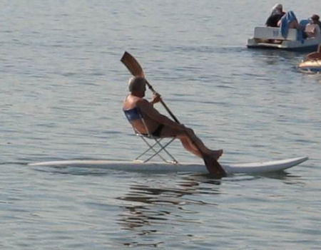
BAD EATING HABITS??
LACK OF EXERCISE??

Slide 14
HOW HEALTHY ARE YOU?
QUIZ ON PHYSICAL HEALTH
QUIZ ON MENTAL HEALTH
QUIZ ON SOCIAL HEALTH

Slide 15
Physical Health
1- I eat breakfast everyday
2- I eat what I believe to be a well-balanced diet.
3-I choose healthy snacks that are low in sugar and salt.
4- I get at least 8 hours of sleep each night.
5- I exercise regularly
6- I do not use tobacco
7- I do not use alcohol or drugs

Slide 16
8- I brush and floss my teeth daily
9- I am within 5 pounds of my ideal weight
10-I usually feel good and have plenty of energy.
1 point for yes
Score: 9-10 = very good
6-8 = good
4-5 = fair
0-4 = needs work

Slide 17
MENTAL HEALTH
1- I have a variety of interests and enjoy learning new things
2- I can laugh easily
3- I like to be alone sometimes
4- I can name several things I do well
5- I can name at least two reasons why people like me
6- I can say no to other people without feeling guilty

Slide 18
7- I can express my thoughts and feelings to others
8- I feel satisfied with my effort if I’ve done my best
9- I ask for help if I need it
10- I try to work through my problems and take responsibility for my actions

Slide 19
SOCIAL HEALTH
1- I meet people easily
2- I have several close friends
3- If I have a problem with someone, I try to talk about it and work it out
4- When working with a group, I can accept other people’s ideas or suggestions
5- I say no to my friends if they are doing something I do not want to do
6- I do not talk about others behind their backs

Slide 20
7- I get along well with several different groups
8- I continue to take part in an activity after I’ve lost an argument
9- I accept the differences in my friends and classmates
10- I enjoy going to different places and having new social experiences

Slide 21
MEDIA AND TECHNOLOGY
Radio, television, film, newspapers, magazines, books, and the internet play a powerful role in shaping public opinion
Which are positives in the Media?
Which are negatives in the Media?

Slide 22


Slide 23
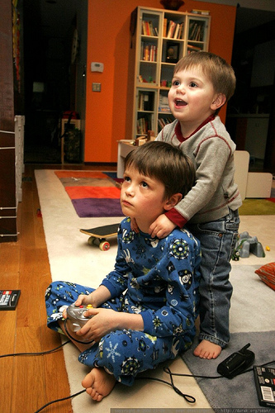

Slide 24


Slide 25


Slide 26


Slide 27


Slide 28

Bill Gates gives millions to better educate children

Slide 29
RISK BEHAVIORS-
  action that can potentially threaten your health or the health of others

Slide 30
ABSTAINING FROM RISKY BEHAVIOR
ABSTINENCE- avoiding harmful behaviors
  Tobacco, alcohol, drugs, and sex

Slide 31
Avoiding high-risk behaviors and choosing friends who do is one of the best ways to achieve and maintain wellness

