Slide 1
VIOLENCE PREVENTION

Slide 2
PROTECTIVE FACTORS:
Behaviors you can practice to stay safe
Take precautions against risky situations and developing safety habits.

Slide 3
SMART PRECAUTIONS
Avoid unsafe areas
Don’t carry your wallet or purse in a conspicuous, easy-to-grab place.
Walk briskly and confidently.(Look like you know what your doing)
Avoid walking alone at night, in wooded areas, or dark alleys.
If you drive, park your car in a well-lit area.(Have your keys out, look to make sure no one is inside)

Slide 4
Let your family know where you’re going and when you’ll return
Do not get into an elevator alone with a stranger
Get on and off buses in well-lit areas
If someone you know gives you a ride, ask the person not to leave until you have entered the building
Do not hitchhike or give rides to hitchhikers
Avoid the use of alcohol or other drugs. These substances impair judgment and ability to protect yourself

Slide 5
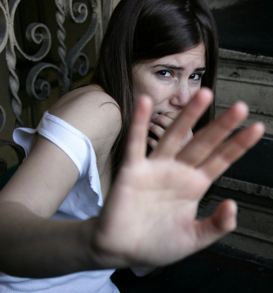
BODY LANGUAGE
Nonverbal communication through gestures, facial expressions, behaviors, and posture

Slide 6
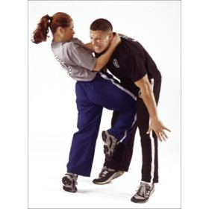
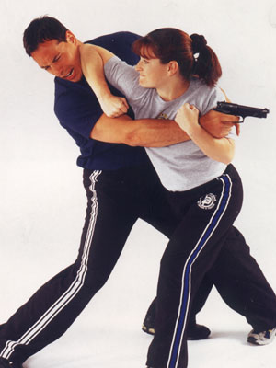
SELF- DEFENSE
Any strategy for protecting oneself from harm

Slide 7
KEEPING HOMES SAFE
Lock doors with a bolt
Make sure windows have locks
Never open the door to someone you don’t know or trust
Do not tell unknown callers that you are home alone
Do not give out personal information over the telephone or computer

Slide 8
HOW TO KEEP OUR COMMUNITY SAFE
Increased police patrol
Neighborhood watch programs
After-school programs
Improved lighting in parks and playgrounds

Slide 9
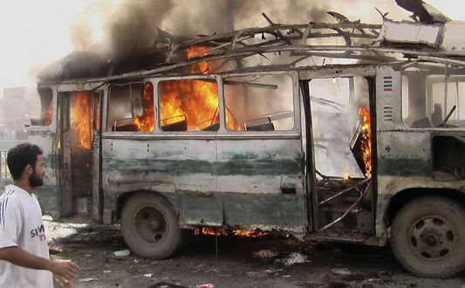
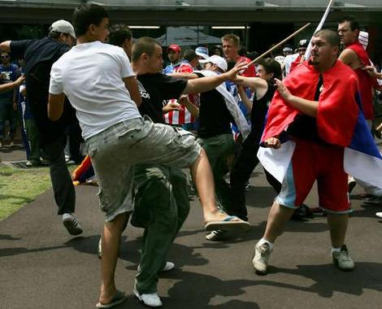
VIOLENCE
The threatened or actual use of physical force or power to harm another person or damage property

Slide 10
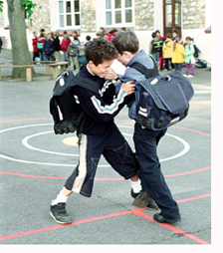
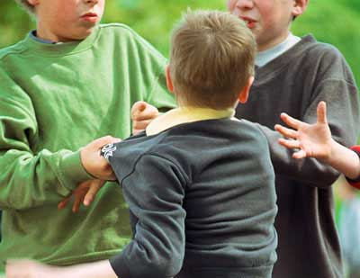
BULLYING
The act of seeking power or attention through the psychological, emotional, or physical abuse of another person

Slide 12
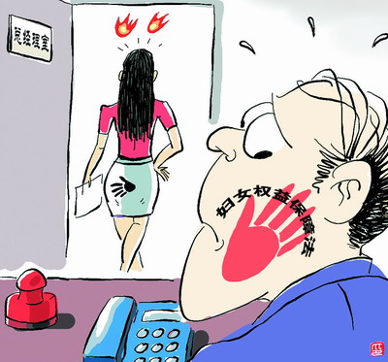
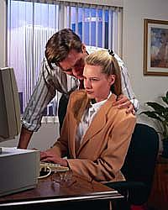
SEXUAL HARASSMENT
Uninvited and unwelcome sexual conduct directed at another person

Slide 13
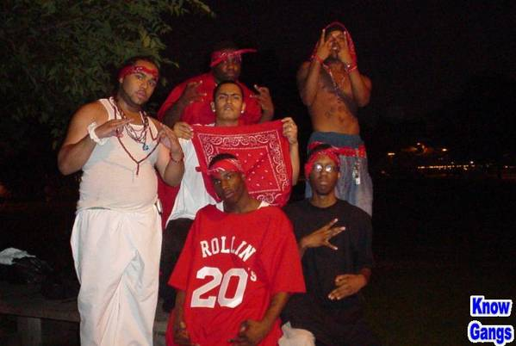
GANGS
A group of people who associate with one another to take part in criminal activity

Slide 14
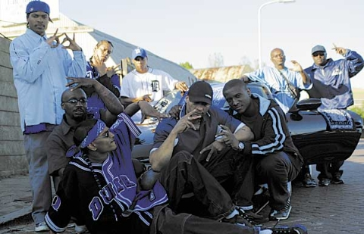
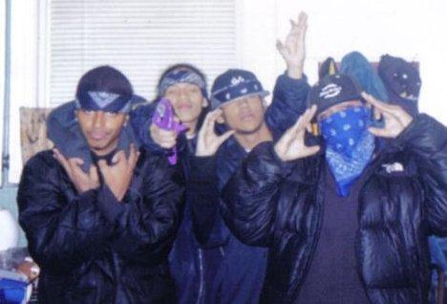

Slide 15
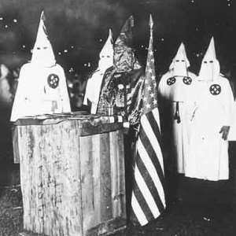

Slide 16
WARNING SIGNS OF VIOLENCE
Has difficulty controlling anger
Disobeys school rules
Frequently engages in risk behaviors
Creates violent artwork or writing
Constantly talks about weapons or violence
Vandalizes and destroys property
Uses alcohol or other drugs
Harms animals
Makes threats or detailed plans to hurt others
Brings or talks about bringing a weapon to school

Slide 18
MAKING YOUR SCHOOL SAFE
1- Refuse to carry weapons and report people who carry them
2- Report any violent acts or threats of violence to school
3- Practice conflict resolution skills and help others settle disputes peacefully
4- Use refusal skills to resist negative peer pressure and avoid unsafe situations and behaviors
5- Choose your friends carefully
6- Avoid spending time with people who show warning signs of violent behavior

Slide 19
7- Tell a parent, teacher, or other adult about your fears if you suspect that your safety is in danger
8- Join or develop a S.A.V.E. chapter (Students Against Violence Everywhere)

Slide 20
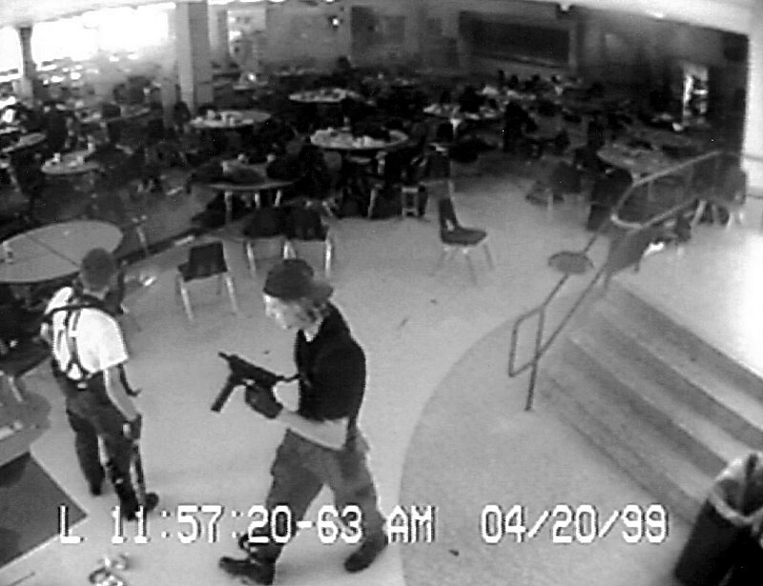
COLUMBINE

Slide 21
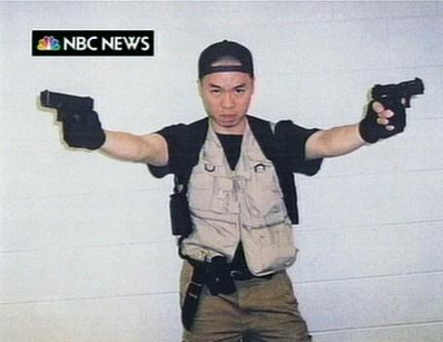
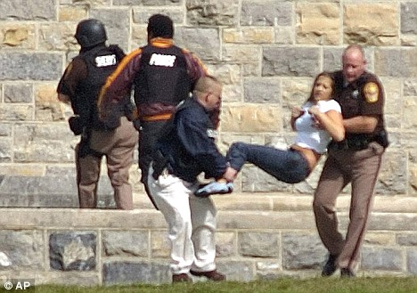
VIRGINIA TECH

Slide 22
PEER MEDIATION
A process in which trained students help other students find fair ways to resolve conflict and settle their differences

Slide 23
PEER MEDIATION SESSION STEPS:
1- Making introductions
2- Establishing ground rules
3- Hearing each side
4- Exploring solutions
5- Closing the session

Slide 24
ASSAILANT
A person who commits a violent act against another

Slide 25
COMMON CAUSES OF VIOLENCE:
Need to control others
Some people use violence to control others or to get something they want
Way of expressing anger
People who are unable to manage their anger may strike out against others in a violent way
Prejudice
Acts of violence are crimes of hate that stem from prejudice
Retaliation
People sometimes use violence to retaliate against-or get back at- others who have hurt them in some way.

Slide 26
TYPES OF VIOLENCE
Assault
An unlawful attack on a person with the intent to harm or kill
Random violence
Violence committed for no particular reason
Homicide
The willful killing of one human being on another
Sexual violence
Any form of unwelcome sexual conduct directed at an individual, including sexual harassment

Slide 27
Sexual assault
Any intentional sexual attack against another person
Rape
Any form of sexual intercourse that takes place against a persons will

Slide 28
ABUSE
The physical, mental/emotional, or sexual mistreatment of one person by another

Slide 29
STALKING
The repeated following, harassment, or threatening of an individual to frighten or cause him/her harm

