Slide 1
PEER RELATIONSHIPS

Slide 2
PEERS
People of similar age who share similar interests

Slide 3
PLATONIC FRIENDSHIP
A friendship with a member of the opposite gender in which there is affection but the two are not considered a couple

Slide 4
TRUE FRIENDSHIPS HAVE SEVERAL COMMON ATTRIBUTES:
Similar values, interests, beliefs on basic issues
Open and honest communication
Sharing of joys, disappointments, dreams, and concerns
Mutual respect, caring, and support
Concern about each other’s safety and well-being

Slide 5
CLIQUE
A small circle of friends, usually with similar backgrounds or tastes, who exclude people viewed as outsiders

Slide 6
stereotype
An exaggerated and oversimplified belief about an entire group of people

Slide 7
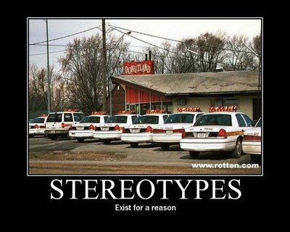

Slide 8
HOW TO STRENGTHEN A HEALTHY FRIENDSHIP?
Be loyal
Encourage each other
Respect each other

Slide 9
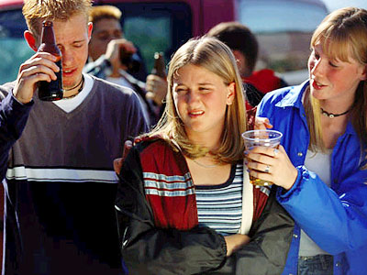
PEER PRESSURE
The influence that people your age may have on you

Slide 10
NEGATIVE PEER PRESSURE
HARASSMENT-
Persistently annoying others
MANIPULATION-
An indirect, dishonest way to control or influence others

Slide 11
COMMON METHODS OF MANIPULATION:
Mocking or teasing another person
Using “guilt trips” to get desired results
Bargaining- offering to make a deal to get what one wants
Using flattery or praise to influence another person
Bribing- promising money or favors if the person will do what is asked
Making threats- promising violence or some other negative consequence if the person does not do what is asked
Using blackmail- threatening to reveal some embarrassing or damaging information if the person does not do what is asked

Slide 12
ASSERTIVE
Standing up for your rights in a firm but positive way

Slide 13
REFUSAL SKILLS
Techniques and strategies that help you say no effectively when faced with something that you don’t want to do or that goes against your values
1- State your position
2- Suggest alternatives
3- Stand your ground

Slide 14
PASSIVE-
A tendency to give up, give in, or back down without standing up for their own rights and needs
AGGRESSIVE-
Overly forceful, pushy, hostile, or otherwise attacking in their approach

Slide 15
DATING
Infatuation-
Exaggerated feelings of passion for another person
Affection-
A feeling of fondness for someone

Slide 16
AVOID RISKY DATING SITUATIONS:
Avoid places where alcohol and drugs are present
Avoid being alone with a date at home or in an isolated place

Slide 19
CURFEW
A set time at which you must be home at night

