Slide 1
FAMILY RELATIONSHIPS

Slide 2
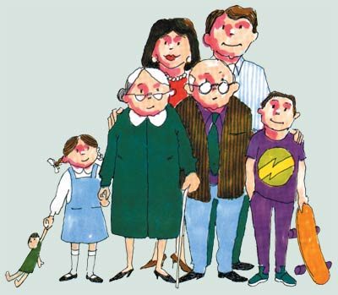
FAMILY
The basic unit of society

Slide 3
FAMILY LIFE AND YOUR HEALTH TRIANGLE
SOCIAL HEATH- family helps its members develop communication skills
PHYSICAL HEALTH- family provides food, clothing, and shelter
EMOTIONAL HEALTH- family members nurture and support one another

Slide 4
EXTENDED FAMILY
Your immediate family and other relatives such as grandparents, aunts, uncles, and cousins

Slide 5
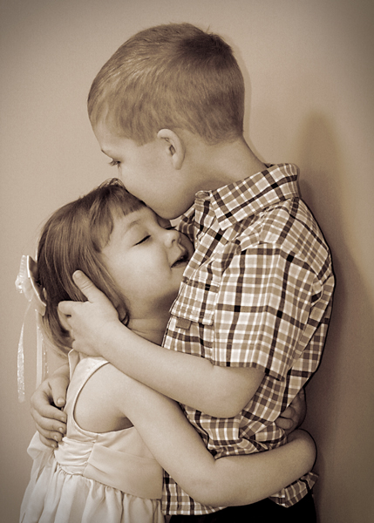
SIBLING
Brother or sister

Slide 6
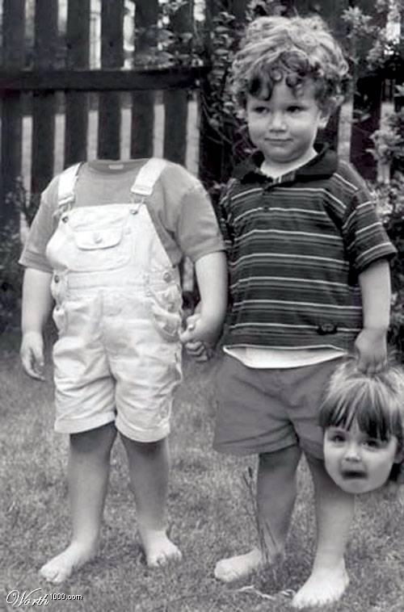

Slide 7
STRENGTHING FAMILY RELATIONSHIPS
1- Demonstrate care and love
2- Show support, especially during difficult times
3- Demonstrate trust
4- Express commitment
5- Be responsible
6- Spend time together
7- Respect individuality
8- Work together to solve problems
9- Be sensitive to others needs

Slide 8
SEPARATION
A decision between married individuals to live apart from each other

Slide 9
DIVORCE
A legal end to a marriage contract

Slide 10
CUSTODY
A legal decision about who has the right to make decisions affecting the children in a family and who has the responsibility of physically caring for them

Slide 11
ADAPTING TO FAMILY DIVORCE
1- Remind yourself that you didn’t cause the problem
2- Do not feel that you have to choose sides
3- Communicate your feelings about divorce with your parents and other trusted adults
4- Take care of yourself by eating nutritious foods, getting physical activity, and managing your stress
5- Consider joining a support group for children of divorce

Slide 12
DEATH OF A FAMILY MEMBER
GRIEF
The sorrow caused by the loss of a loved one
1- Focus on happy memories
2- Accept your feelings
3- Join a support group
4- Seek help from a grief counselor

Slide 13
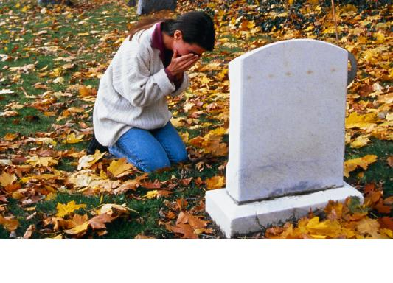

Slide 14
CHANGES IN FAMILY CIRCUMSTANCES:
These changes can cause difficulties for families
MOVING
FINANCIAL PROBLEMS
ILLNESS AND DISABILITY
DRUG AND ALCOHOL ABUSE

Slide 15
HOW TO COPE WITH FAMILY CHANGES
1- Do what you can to help
If your parents are stressed, reduce their burden by taking on chores
2- Read books about the subject or talk to people who have faced a similar problem
You may find strategies for managing the problem
3- Use stress-management techniques
Engage in physical activity, get sleep, eat nutritious meals find a way to relax

Slide 16
RESILIENCY
The ability to adapt effectively and recover from disappointment, difficulty, or crisis

Slide 17
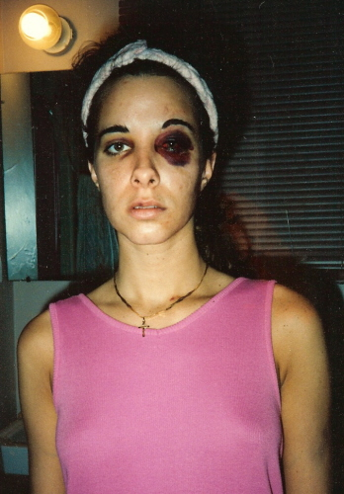
FAMILY VIOLENCE
Domestic abuse-
Any act of violence involving family members

Slide 18
EMOTIONAL ABUSE-
A pattern of behavior that attacks the emotional development and sense of worth of an individual
Examples: Yelling, bullying, name-calling, and threats of physical harm

Slide 19
PHYSICAL ABUSE-
The intentional infliction of bodily harm or injury on another person
Examples: Slapping, punching, kicking, pinching, and throwing objects at another person

Slide 20
SEXUAL ABUSE-
Any sexual contact that is forced upon a person against his or her will.

Slide 21
SPOUSAL ABUSE-
Domestic violence directed at a spouse
Usually when one partner uses physical strength to try to control the other
Also hurts the health of other family members

Slide 22
CHILD ABUSE-
Domestic abuse directed at a child
May include neglect
The failure to provide for a child’s physical, or emotional needs
Physical needs include adequate food, clothing, shelter, and medical care
Emotional neglect may be withholding love and support

Slide 23
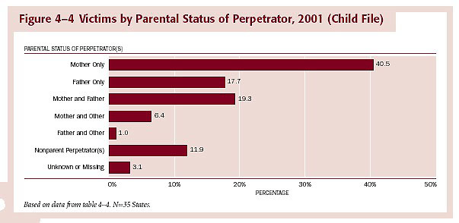

Slide 25
EFFECTS OF ABUSE
1- Inability to trust or establish healthy personal relationships
2- Chronic physical pain
3- Neglect of or injury to oneself, including suicide attempts
4- Depression, anxiety, sleep disorders, and eating disorders
5- Abuse of alcohol and other drugs

Slide 26
CYCLE OF VIOLENCE
Pattern of repeating violent or abusive behaviors from one generation to the next

Slide 28
BREAKING THE CYCLE OF VIOLENCE
1- Tell a trusted adult
2- Contact an abuse hot line or crisis center that can assist you in finding counselors or other forms of help
3- Report the abuse to the police. It may also be appropriate to contact child welfare or youth services

Slide 29
AVOIDING DOMESTIC VIOLENCE
RECOGNIZE
Be aware of acts that are abusive
RESIST
Be assertive and stand up for yourself
REPORT
Report the abuse to authorities or tell an adult who can help

Slide 30
SUPPORT SYSTEMS
Crisis center
A facility that handles emergencies and provides referrals to an individual needing help
Foster care
A temporary arrangement in which a child is placed under the guidance and supervision of a family or an adult who is not related to the child by birth
Family counseling
Therapy to restore healthy relationships in a family
Mediator
A person who helps others resolve issues to the satisfaction of both parties

Slide 31
SOURCES OF HELP FOR FAMILIES
FAITH COMMUNITIES
COMMUNITY SERVICES
POLICE
HOSPITALS/CLINICS
SHELTERS
MEDICATION
FAMILY COUNSELING
SUPPORT GROUPS
SUBSTANCE ABUSE TREATMENT FACILITIES

Slide 32
FOSTER CARE-
A temporary arrangement in which a child is placed under the guidance and supervision of a family or an adult who is not related to the child by birth

Slide 33
FAMILY SUPPORT SERVICES
Al-Anon-
Support for family members of people addicted to substances such as alcohol and other drugs
Alateen-
A support group for teens who live with someone addicted to alcohol or other drugs
Conflict Resolution Center-
Offers counseling, medication, and training to help resolve conflicts

Slide 34
Family Resource Center-
Provides support for families, including counseling services
Family Services-
Provides counseling for individuals, couples, and families
Teens in Transition-
Offers resources for teens seeking help for difficult life problems, such as coping with divorce or death

Slide 35
HOW TO MAINTAIN YOUR HEALTHY FAMILY??
COOPERATE
SHOW APPRECIATION
BE A GOOD COMMUNICATOR
OFFER HELP
BE EMPATHETIC
WORK TO RESOLVE CONFLICTS
KNOW WHEN TO GET OUTSIDE HELP

