Slide 1
CPR AND FIRST AID

Slide 2
FIRST AID
The immediate, temporary care given to an ill or injured person until professional medical care can be provided

Slide 3
UNIVERSAL PRECAUTIONS
Actions taken to prevent the spread of disease by treating all blood and other bodily fluids as if they contained pathogens

Slide 4
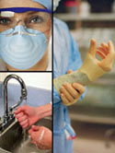

Slide 5
STEPS TO TAKE IN AN EMERGENCY SITUATION
1- Check the scene and the victim
Make sure scene is safe
2- Call for help
Dial 911
3- Provide care for the victim

Slide 6
TYPES OF INJURIES
ABRASION
LACERATION
PUNCTURE
AVULSION

Slide 7
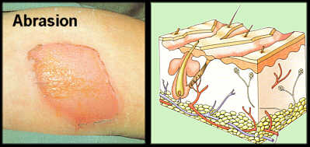
ABRASION
Skin is scrapped against a hard surface
Very important to clean the wound because of the way the injury occurs

Slide 8
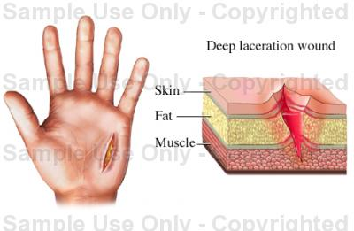
LACERATION
A cut caused by a sharp object, such as a knife or glass, slicing through layers of skin

Slide 9
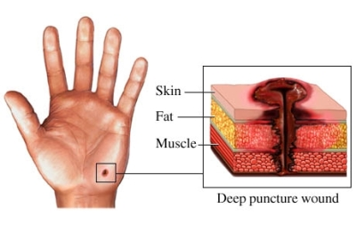
PUNCTURE
A small but deep hole caused by a pin, nail, or other object

Slide 10
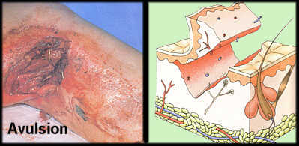
AVULSION
Results when tissue is partially or completely separated from the body

Slide 11
FIRST AID FOR BLEEDING
Cover the wound with sterile gauze or a clean cloth and press firmly
If possible, elevate the wound above the level of the heart
Cover the gauze or cloth with a sterile bandage
If necessary, cover the dressing with a pressure bandage
Call for help

Slide 12
TYPES OF BURNS AND TREATMENT
First-degree burn
Only the outer layer of skin is burned
Cool the burn with cold running water
Second-degree burn
the top several layers of skin are damaged
Cool the burn with cold water, seek a doctor
Third-degree burn
Serious burn in which deeper layers of skin and possibly fat, muscle, nerves, and bone are damaged
Medical help immediately

Slide 13
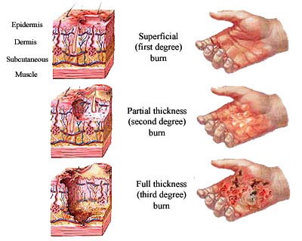

Slide 14
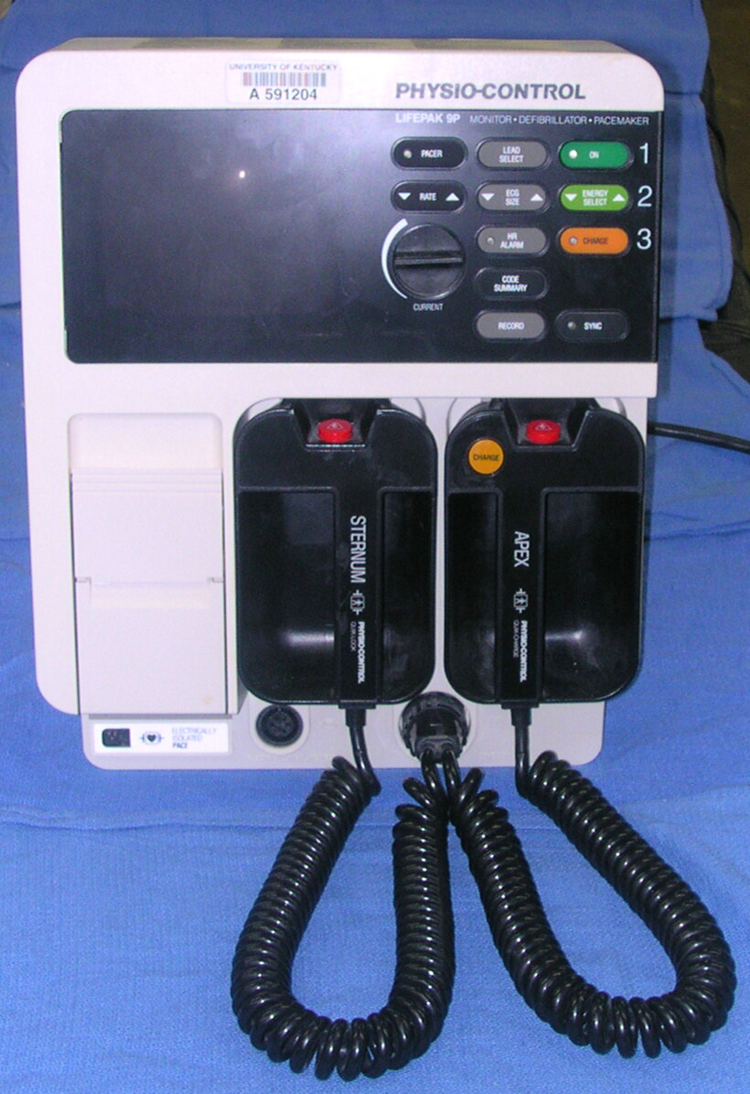
DEFIBRILLATOR
A device that delivers an electric shock to the heart to restore its normal rhythm

Slide 15
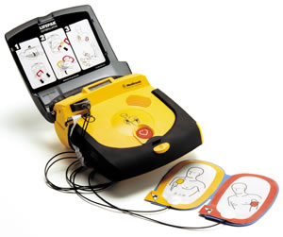
AUTOMATED EXTERNAL DEFIBRILLATOR (AED)
A handheld device that almost anyone can be trained to used

Slide 16
CPR
Cardiopulmonary resuscitation
A life-saving first-aid procedure that combines rescue breathes with chest compressions, supplying oxygen to the body until normal body functions can resume

Slide 17
THE ABC’S OF ADULT CPR
A
AIRWAY
Make sure nothing is blocking
B
BREATHING
Look for chest movement
C
CIRCULATION
Check for signs

Slide 18
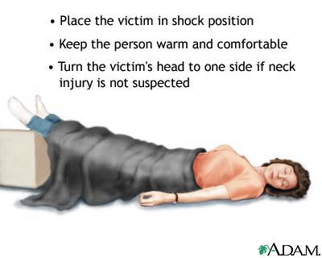
SHOCK
A failure of the cardiovascular system to keep an adequate supply of blood circulating to the vital organs of the body

Slide 19
CHOKING
Occurs when a person’s airway becomes blocked by food or swallowed object
Universal sign of choking is when a person clutches their throat with one or both hands
Ask “Are you choking? Can you speak?”

Slide 20
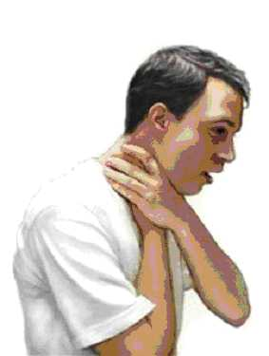

Slide 21
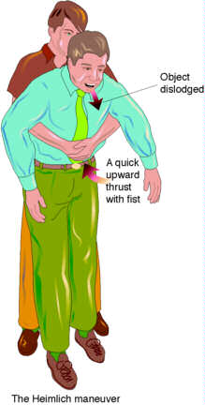
HEIMLICH MANEUVER

Slide 22
MUSCLE CRAMPS
The sudden and painful tightening of a muscle
Stretch out the affected muscle
Massage the cramped muscle firmly
Apply moist heat to the area
Get medical help if cramp persists

Slide 23
Strains and sprains
Strain- an injury to a muscle, usually resulting from overuse of a muscle
Sprain- an injury to a ligament

Slide 24
TREATMENT: R.I.C.E.
R
Rest- avoid movement
I
Ice- reduces pain and swelling
C
Compression- light pressure (wrap in ace bandage)
E
Elevate- raise above heart level

Slide 25
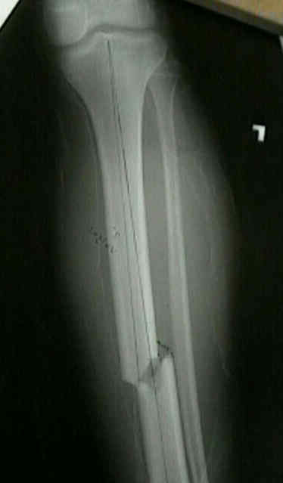
FRACTURES
Simple fracture- a break in the bone, sometimes called a hairline fracture

Slide 26
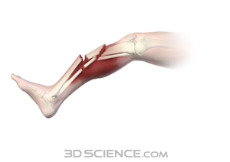
Compound fracture- a complete break of the bone. Sometimes sticks out of skin

Slide 29
UNCONSCIOUSNESS
A condition in which a person is not alert and aware of his/her surroundings
Different levels of unconsciousness from drowsiness to coma

Slide 30
FAINTING
Occurs when the blood supply to the brain is temporarily inadequate
Usually brief

Slide 31
CONCUSSION
A jarring injury to the brain that affects normal brain function
Get professional medical help

Slide 32
POISONINGS
Poison
Any substance- solid, liquid, or gas- that causes injury, illness, or death when introduced to the body

Slide 33
VENOM-
A poisonous substance secreted by a snake, spider, or other creature

Slide 34
POISON CONTROL CENTER
A 24-hour hot line that provides emergency medical advice on treating poisoning victims

Slide 35
FIRST AID FOR POISONING
1- Swallowed poisons
Call poison control and follow instructions

Slide 36
2- Inhaled poisons-
Serious because of damage that can be done to the lungs
Get person to fresh air
Get medical help

Slide 37
3- Poison to skin-
Removed as quickly as possible to limit exposure to the body
Rinse continuously with water for 15 mins.
Call 911

Slide 38
4- Poison to eye-
Immediately start flushing eye with lukewarm water for 15 min
Have victim blink the eye as much as possible
Do not rub eye
Call 911

