Slide 1
ENVIRONMENTAL HEALTH

Slide 2
AIR POLLUTION
The contamination of the earth’s atmosphere by substances that pose a health threat to living things

Slide 3
FIVE COMMON AIR POLLUTANTS
OZONE
PARTICULATE MATTER
CARBON MONOXIDE
SULFUR DIOXIDE
NITROGEN OXIDES

Slide 4
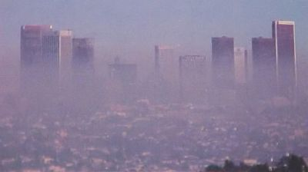
OZONE
A gas composed of three oxygen atoms.
SMOG- a yellowish-brown haze that forms when sunlight reacts with air pollution

Slide 5
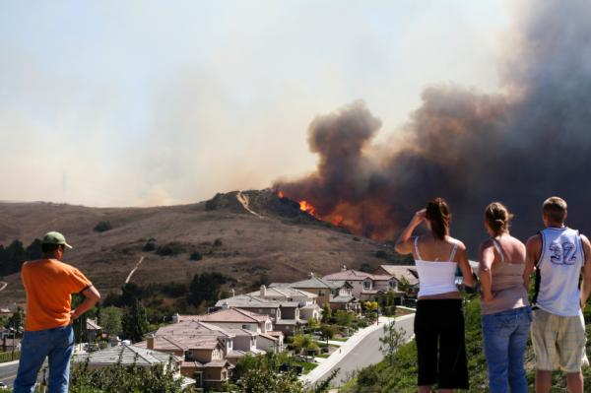
PARTICULATE MATTER
A general term for particles such as dust, dirt, soot, smoke, mold, or liquid droplets that are found in the air.

Slide 6
CARBON MONOXIDE
A colorless, odorless gas that contains carbon and oxygen.

Slide 7
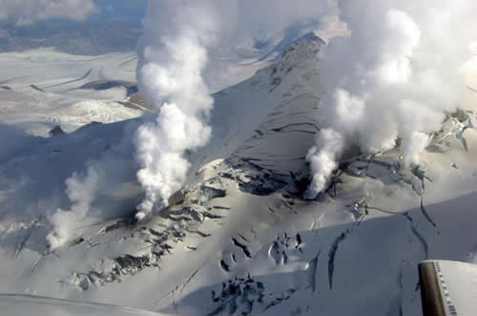
SULFUR DIOXIDE
A gas made up of sulfur and oxygen. It dissolves in water to form an acid, and reacts with other gases in the air to form sulfates

Slide 8
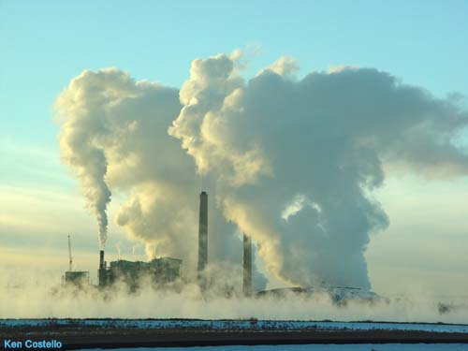
NITROGEN OXIDES
A general term for a group of highly reactive gases that contain varying amounts of nitrogen and oxygen.

Slide 9
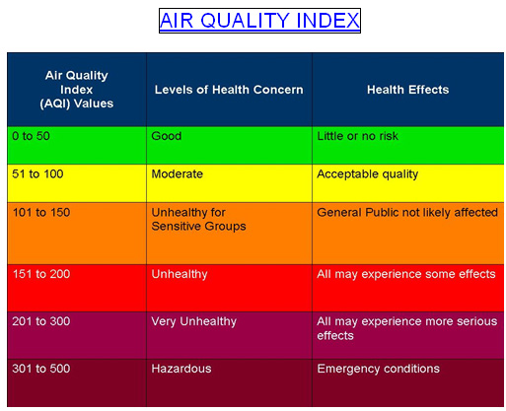
AIR QUALITY INDEX (aqi)
An index for reporting daily air quality

Slide 10
ASBESTOS
A fibrous mineral that has fireproof properties
RADON
An odorless, radioactive gas

Slide 11
NOISE POLLUTION-
A harmful and unwanted sound of sufficient intensity to damage hearing
DECIBEL-
A unit used to express the relative intensity of loudness of sound

Slide 15
DECIBEL LEVELS OF COMMON SOUNDS

Slide 16
BIODEGRADABLE
Able to be broken down by microorganisms in the environment
LANDFILL
An area that has been safeguarded to prevent disposed wastes from contaminating groundwater

Slide 17
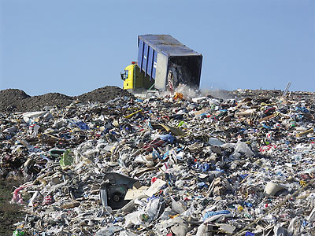

Slide 18
HAZARDOUS WASTE
A substance that is explosive, corrosive, highly reactive, or toxic to humans or other life forms

Slide 20
DEFORESTATION
Destruction of forests

Slide 21
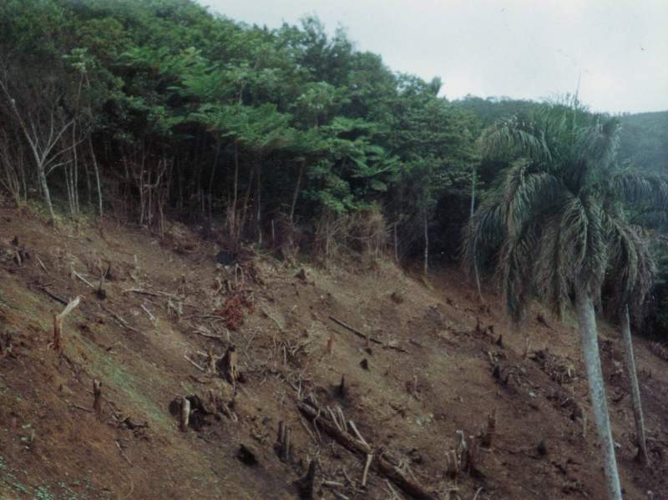

Slide 22
URBAN SPRAWL
The spreading of city development onto undeveloped land

Slide 24
WASTEWATER
Used water that comes from homes, communities, farms, and businesses

Slide 25
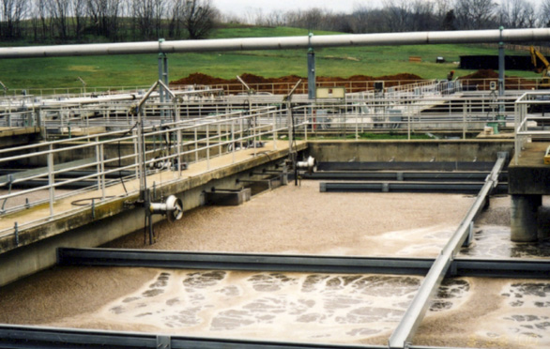

Slide 26
OTHER SOURCES OF WATER POLLUTION
SEDIMENT
From land erosion can destroy aquatic ecosystems and clog lakes, streams, channels, and harbors
OIL
Some comes from the cleaning of oil tankers and from offshore drilling sites. Problems are also from when people dump motor oil or household chemicals down storm drains

Slide 29
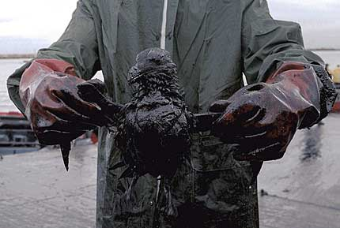

Slide 30
WHAT CAN YOU DO TO HELP??
1- Recycle
2- Dispose of all materials properly
3- Follow directions when using chemicals such as cleaning products and pesticides
4- Reduce water usage

Slide 31
CONSERVATION
The protection and preservation of the environment by managing natural resources to prevent abuse, destruction, and neglect

Slide 32
HEATING AND COOLING
Seal leaks around doors, windows, and electrical sockets to prevent heated and cooled air from escaping
During heating season, wear an extra layer of clothing instead of turning up the thermostat. (68 degrees)
Keep thermostat at 78 degrees during air-conditioning season

Slide 33
WATER CONSERVATION
Wash clothes in warm or cold water. Accumulate a full load before washing laundry or running the dishwasher.
Fix leaky faucets, and never let the water run unnecessarily. Turning off the water while brushing your teeth or shave can save 4.5 gallons of water per minute.

Slide 34
LIGHTING AND APPLIANCES
Replace traditional lightbulbs with fluorescent bulbs.
Switch off lights when you leave a room
Turn off tv’s, radios, computers, and other appliances when not in use
Use a microwave or toaster oven instead of a conventional oven when cooking a small amount of food
Don’t preheat oven for longer than necessary. Avoid opening the oven door unnecessarily while the appliance is in use.

Slide 35
PRECYCLING-
Reducing waste before it is generated- (purchasing and using products wisely)
RECYCLING-
The processing of waste materials so that they can be used again

Slide 36
TIPS FOR RECYCLING AND REDUCING WASTES
Aluminum-
Rinse aluminum and crush cans
Cardboard-
Flatten cardboard
Glass-
Rinse
Plastics-
Look for code on container. Most recyclers take those marked 1, 2, or 3.
Newspapers-
Stack newspapers and tie in bundles
Glossy paper-
Contact services that help you remove your name from mailing lists

