Slide 1
COMMUNICABLE DISEASES

Slide 2
COMMUNICABLE DISEASE
A disease that is spread from one living thing to another or through the environment

Slide 3
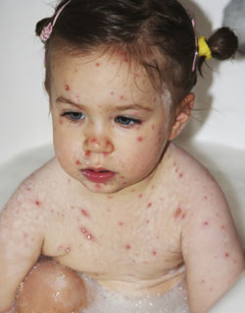
CHICKEN POX

Slide 4
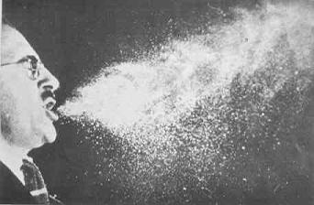

Slide 5
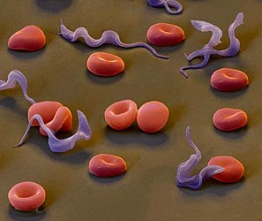
PATHOGEN
An organism that causes disease

Slide 6
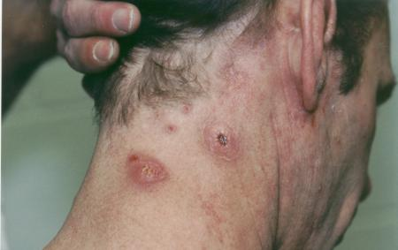
INFECTION
A condition that occurs when pathogens enter the body, multiply, and damage body cells
STAPH

Slide 7
VIRUSES
Pieces of genetic material surrounded by a protein coat

Slide 8
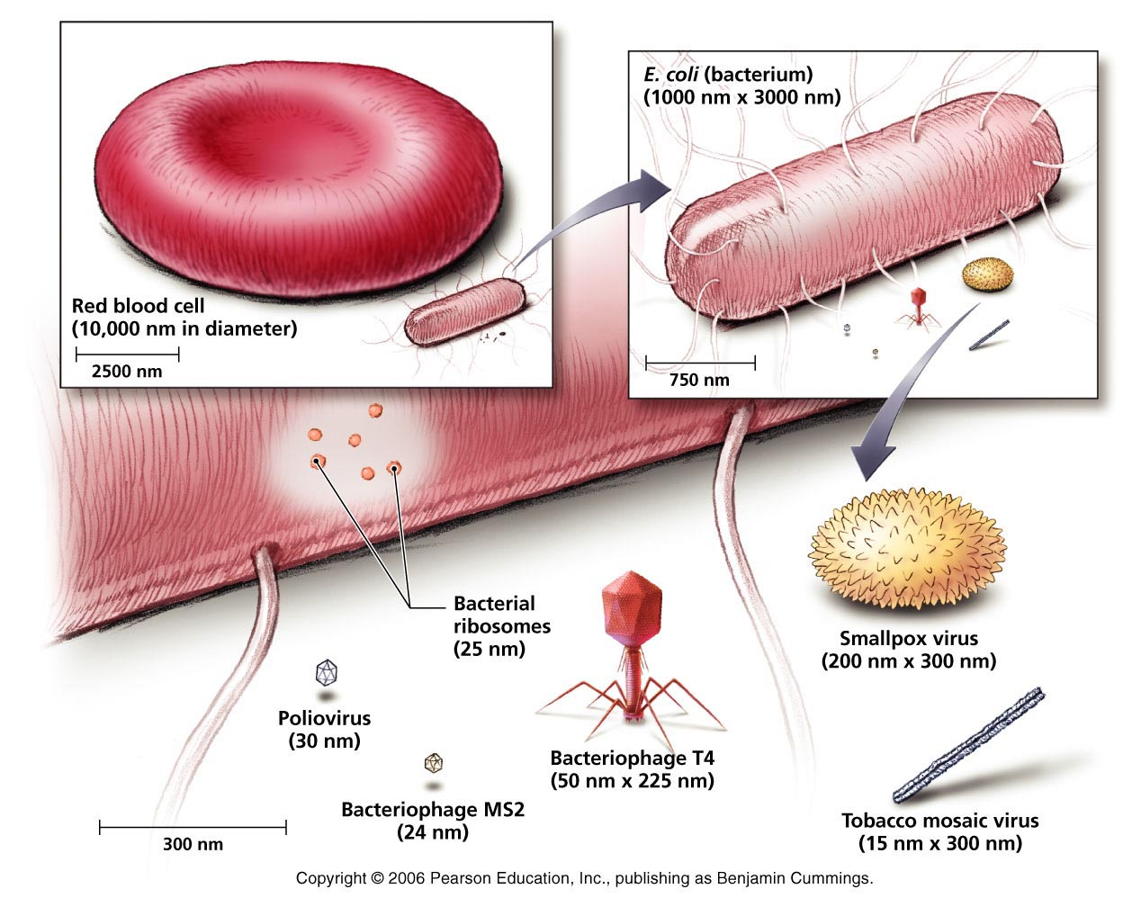

Slide 9
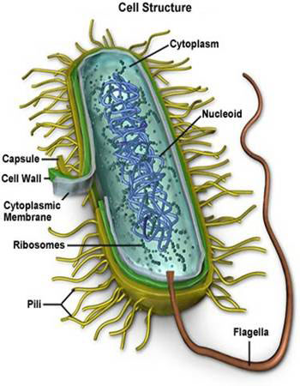
BACTERIA
Single-celled microorganisms

Slide 10
TOXIN
A substance that kills cells or interferes with their functions

Slide 11
DISEASES BY TYPE OF PATHOGEN
VIRUSES
Common cold
Flu
Polio
Mono
Aids
Chicken pox
Rabies
Herpes

Slide 12
BACTERIA
Strep throat
Tuberculosis
Gonorrhea
Lyme disease
Pinkeye
Meningitis

Slide 13
FUNGI
Athlete’s foot
Ringworm

Slide 14
PROTOZOANS
Malaria
Amoebic dysentery
Sleeping sickness

Slide 15
HOW COMMUNICABLE DISEASES ARE TRANSMITTED
DIRECT CONTACT
By an infected person or animal or with something in the environment
Examples: touching, biting, kissing, and sexual contact

Slide 16
INDIRECT CONTACT
Contaminated objects- someone with a cold sneezes onto a table or into his/her hand and then touches the table
Vectors- an organism, usually an arthropod, such as a tick, that carries and transmits pathogens to humans or other animals
Water and food- salmonella, bacteria in undercooked poultry

Slide 17
PREVENTING THE SPREAD OF DISEASE
Washing hands
Avoid sexual contact
Avoid contact with people who are ill
Avoid sharing utensils
Prepare and store food safely
Be sure you are vaccinated

Slide 18
IMMUNE SYSTEM
A network of cells, tissues, organs, and chemicals that fights off pathogens
INFLAMMATORY RESPONSE-
A reaction to tissue damage caused by injury or infection
PHAGOCYTE-
A white blood cell that attacks invading pathogens

Slide 19
ELEMENTS THAT WORK TOGETHER AS YOUR BODY’S FIRST LINE OF DEFENSE TO PREVENT PATHOGENS FROM ENTERING AND CAUSING DISEASE
SKIN
TEARS AND SALIVA
MUCOUS MEMBRANES
CILIA
GASTRIC JUICE

Slide 20
ANTIGEN
A substance that is capable of triggering an immune response
IMMUNITY-
The state of being protected against a particular disease

Slide 21
LYMPHOCYTES
A specialized white blood cell that coordinates and performs many of the functions of specific immunity
TYPES: T cells and B cells

Slide 22
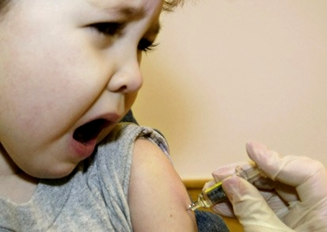
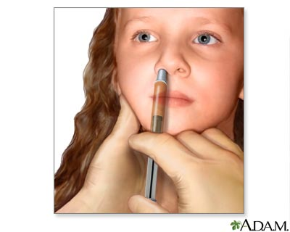
VACCINE
A preparation of dead or weakened pathogens that are introduced into the body to stimulate an immune response

Slide 23
CARE OF THE IMMUNE SYSTEM
Follow a sensible eating plan to maintain your overall health and keep your immune system strong
Get plenty of rest
Get about an hour of physical activity each day
Avoid sharing personal items such as towels, toothbrushes, hairbrushes, or makeup
Avoid tobacco, alcohol, and other drugs
Avoid sexual contact
Keep your immunizations up to date

Slide 24
VACCINES TO AID THE BODY’S DEFENSES
Live-virus vaccines
Grown under lab conditions (measles, mumps, chickenpox)
Killed-virus vaccines
Dead pathogens that stimulates an immune response (flu shots, rabies, hepatitis A)
Toxoids
Inactivated toxins (tetanus, and diphtheria)
New and second-generation vaccines
New technologies (hepatitis B)

Slide 25
RESPIRATORY INFECTIONS
COMMON COLD
Viral infection that causes inflammation of the mucous membranes that line the nose and throat
INFLUENZA
Flu, viral infection of the respiratory tract
PNEUMONIA
An infection of the lungs in which the air sacs fill with pus and other liquid
STREP THROAT
A bacterial infection spread by direct contact
TUBERCULOSIS
TB, a bacterial disease that usually attacks the lungs

Slide 26
HEPATITIS
Inflammation of the liver and can be caused by chemicals, including drugs or alcohol
HEPATITIS A
Most commonly spread through contact with feces of an infected person
Symptoms: fever, nausea, vomiting, fatigue, jaundice
Most recover completely

Slide 27
HEPATITIS B
More serious than A, is found in mostly bodily fluids of an infected person, especially blood
Through sexual contact, body piercings and tattooing using contaminated needles
Symptoms: liver damage
Can get a vaccine

Slide 28
HEPATITIS C
Most common chronic blood-borne infection
Most often transmitted by direct contact with infected blood through contaminated needles shared by drug users
Liver disease, liver cancer, liver failure
No cure

Slide 29
EMERGING INFECTION
A communicable disease whose incidence in humans has increased within the past two decades or threatens to increase in the near future

Slide 30
FACTORS THAT ARE CONTRIBUTING TO THE DEVELOPMENT OF EMERGING FACTORS
Transport across boarders
Population movement
Resistance to antibiotics
Changes in food technology
Agents of bioterrorism

Slide 31
