Slide 1
ALCOHOL

Slide 2
ETHANOL-
  the type of alcohol in alcoholic beverages
FERMENTATION-
  the chemical action of yeast on sugars

Slide 3
EFFECTS OF ALCOHOL CONSUMPTION
DEPRESSANT-
  a drug that slows the central nervous system
INTOXICATION-
  the state in which the body is poisoned by alcohol or another substance and the person’s physical and mental control is significantly reduced

Slide 4
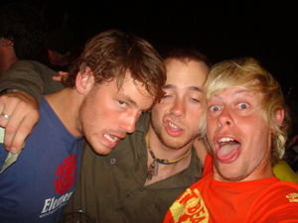
INTOXICATED….FUN???

Slide 5
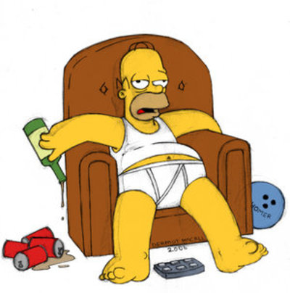

Slide 6
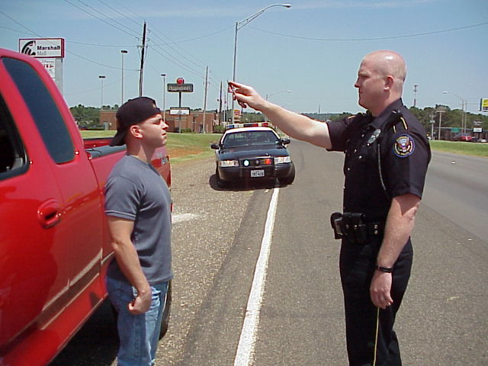

Slide 7
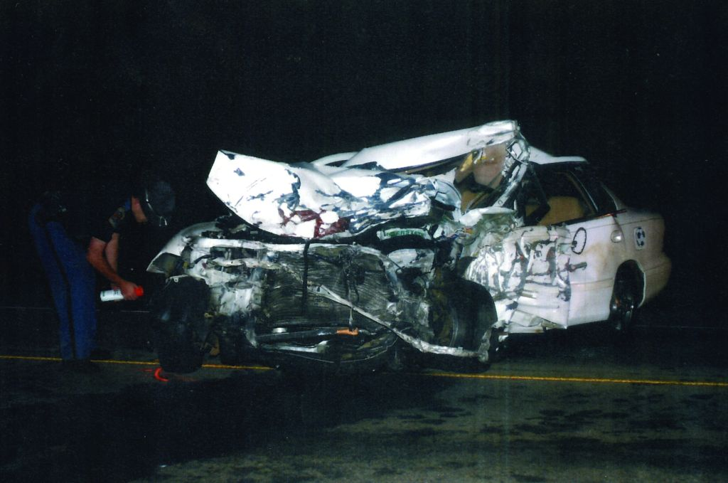

Slide 8
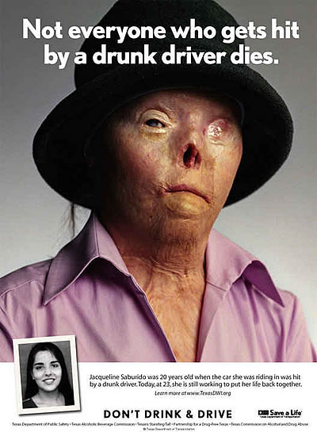

Slide 9


Slide 10
FACTORS THAT INFLUENCE ALCOHOL USE
PEER PRESSURE
  Teens want to be accepted. Teens who avoid alcohol are more likely to be friends with peers that don’t drink.
FAMILY
  Parents who discourage and avoid alcohol use have children more likely to do the same
MEDIA MESSAGES
  Adds make alcohol appear fun, exciting. Teens that recognize these lies are more likely to resist alcohol

Slide 11
ADVERTISING TECHNIQUES
Companies use various strategies to advertise and sell their product
They always associate their product with attractive and healthy people having fun

Slide 12

FANTASY

Slide 13


Slide 14


Slide 15
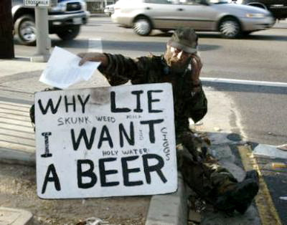
REALITY

Slide 16
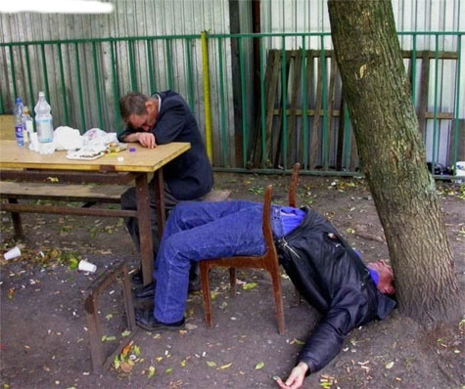

Slide 17
ALCOHOL AND THE LAW
If you are under 21, it is illegal to buy, posses, or consume alcohol
Teens can be arrested, fined, and sentenced to youth detention centers

Slide 18
ALCOHOL, VIOLENCE, AND SEXUAL ACTIVITY
More likely to be victims or perpetrators of violent crimes such as rape, aggravated assault, and robbery
Teens who use alcohol are more likely to become sexually active at earlier ages, to engage in sexual activity more often, and to engage in unprotected sexual activity.
Can lead to unplanned pregnancy, sexually transmitted diseases, and emotional scars

Slide 19
BEING ALCOHOL FREE
THIS COMMITMENT HELPS YOU:
  Maintain a healthy body
  Make responsible decisions
  Avoid risky behavior
  Avoid illegal activities

Slide 20
EFFECTS OF DRINKING
Body size and gender
    Small people and females feel the effect faster
Food
    A full stomach slows down alcohol to the bloodstream
Amount and rate of intake
    How much and how fast

Slide 21
WHAT EFFECTS DOES ALCOHOL HAVE ON YOUR SYSTEMS??
NERVOUS SYSTEM
Brain- becomes less able to control the body. Movement, speech, and vision may be affected
Memory- thought processes are disorganized, and memory and concentration are dulled
Judgment- altered and coordination is impaired

Slide 22
CARDIOVASCULAR SYSTEM
Heart- with a low intake alcohol causes an increase in heart rate and blood pressure. At higher intake levels, heart rate and blood pressure decrease and heart rhythm becomes irregular. Risk of cardiac arrest increases.
Blood Vessels- alcohol causes the blood vessels to expand. The increased surface area of the blood vessels allows body heat to escape and the body’s temperature to drop

Slide 23
DIGESTIVE SYSTEM
Stomach- some alcohol passes quickly from the stomach into the bloodstream. Stomach acid production increases and often results in nausea and vomiting.
Liver- toxic chemicals are released as the liver metabolizes alcohol. These chemicals cause inflammation and scarring.
Kidneys- alcohol causes the kidneys to increase urine output, which can lead to dehydration.

Slide 24
RESPIRATORY SYSTEM
Lungs- carbon dioxide formed by the liver is released from the body through the lungs.
Breathing- alcohol depresses nerves that control involuntary functions such as breathing. If an excessive amount of alcohol is consumed, breathing may slow, become irregular, or stop.

Slide 25
BLOOD ALCOHOL CONCENTRATION
(BAC)
The amount of alcohol in a person’s blood, expressed as a percentage

Slide 26
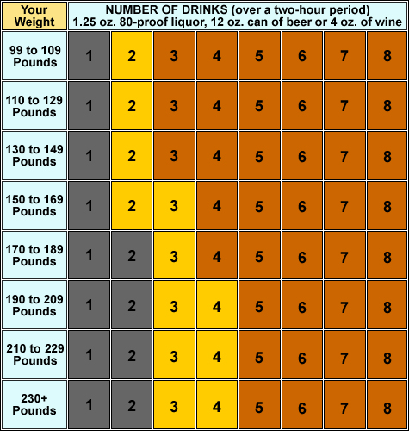

Slide 27
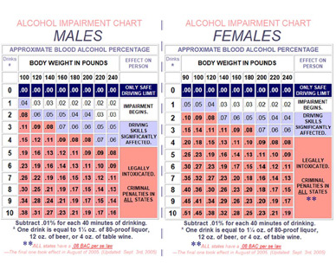

Slide 28
MEDICAL RESEARCHERS HAVE FOUND THAT DRINKING OF ANY SORT CAN:
Slow reflexes
Reduce a person’s ability to judge distances
Increase risk-taking behaviors
Reduce a person’s concentration while increasing forgetfulness

Slide 29
CONSEQUENCES OF DUI
Harm to the driver and others
Severely restricted driving privileges and/ or immediate confiscation of a driver’s license
Alcohol-related injuries, property damage, and death
Living with regret and remorse from these consequences
Loss of parental trust and respect
Arrest, jail time, court appearances, and a heavy fine or bail
A police record and possible lawsuits
Higher insurance rates

Slide 30
BINGE DRINKING
Drinking five or more alcoholic drinks at one sitting
Rapid drinking, can cause alcohol poisoning
    ALCOHOL POISONING
      A severe and potentially fatal physical reaction to an alcohol overdose

Slide 31
Alcohol and Drug Use in College Fraternities
There is a long standing tradition at college fraternity houses that has been occurring since the beginning of time and that is alcohol and drug use. It has been known for the longest time that alcohol and drugs are being used in frat houses, but as of late their has been an increase in concern among college officials about the dangers of these rituals. Granted their have been a few unfortunate incidents that have come from alcohol and drug abuse at the houses around the country. But the real question being asked is, are fraternities really to blame for these unfortunate incidents? The first issue to discuss is do alcohol and drugs coincide with the hazing that occurs in fraternity houses? A man by the name of Hank Nuwer, wrote an article for the Stop Hazing Organization about a particular incident in 1993, where Chad Saucier a pledge for the Phi Delta Theta's of Auburn University died grotesquely from alcohol poisoning. Being that I know Chad's sister, this was an issue which is close to my heart. What happened was Chad went to the traditional Phi Delta Theta Christmas Party and once their, it was said that he proceeded to drink enough whiskey and Jagermister to kill three men. It goes witho
" He ended the article by saying that very few all pledge experiences are horrifying or even demoralizing. The act of "binge" drinking had supposedly occurred at a rate of 75 percent among greeks and 35 among none greeks. Many other institutions have developed new ways to involve campus Greek societies in alcohol-prevention work. In this article he raised the question, should it be allowed? He began by telling a story about his former days in college in which he remembers the very first day he got his pin. If the problems that come from alcohol and drug use in fraternities are going to be fixed, then it is going to require that a very large majority of the greek system becomes interested in change. The third and final issue is do residents of greek society houses really consume alcohol at greater levels than those who are not in greek society? According to a campus poll conducted by campusblues. He raised a question for himself when he said if he knew then what he knows now, would he go through it again? Absolutely, was his answer. What can be done in order to prevent college students from diving head first into these sort of problems? Well, at some colleges no alcohol is being served during "rush" the period when new students pledge fraternities and sororities. But, in the end the real truth is that most college students don't want to receive help from people on the outside. William Raspberry said the reason so many people are crusading against hazing, is because they don't understand that going through hell with your pledge brothers is something that creates a stronger bond of friendship and loyalty. And as usual that somebody happens to be the fraternities. Towards the end of the article he started recalling a particular incident which occurred on a standard pledge retreat, in which 27 of his pledge brothers and himself were forced to strip down to their boxers and swim around in the icy cold water. And, based on the data that has been collected, most researchers seriously doubt if this so-called problem will ever be dealt with. Once the incident had completely unfolded the President of the school made a statement in which said, "I am dealing with several other cases that were very similar to Chad Saucier's and I wish these incidents would stop occurring at the fraternity houses. " So should this statement be applied to this issue? In the The Daily Record an article was written by William Raspberry.

Slide 32


Slide 33
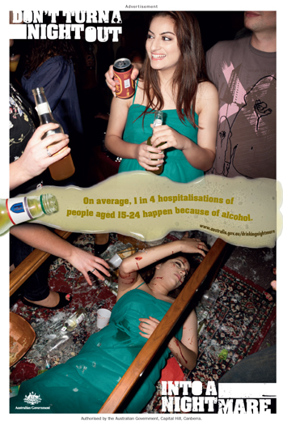

Slide 34
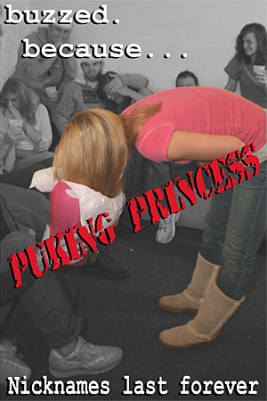

Slide 35
EFFECTS OF ALCOHOL POISONING
Mental confusion, stupor coma, inability to be roused, vomiting, and seizures
Slow respiration- 10 seconds between breaths or fewer than 8 breaths a minute
Irregular heartbeat
Hypothermia or low body temperature- pale or bluish skin color
Sever dehydration from vomiting

Slide 36
ALCOHOLISM:
A DISEASE IN WHICH A PERSON HAS A PHYSICAL OR PSYCHOLOGICAL DEPENDENCE ON DRINKS THAT CONTAIN ALCOHOL

Slide 37
ALCOHOLIC
  An addict who is dependent on alcohol
      SYMPTOMS
        Craving
        Loss of control
        Physical dependence
        Tolerance
        Health, family, and legal problems

Slide 38
STAGES OF ALCOHOLISM
STAGE 1- ABUSE
  Begins to drink and become intoxicated regularly
STAGE 2- DEPENDENCE
  Reaches a point where they cannot stop drinking
STAGE 3- ADDICTION
  Most important thing in their life
  Life becomes out of control

Slide 39
ALCOHOL ALSO PLAYS A MAJOR ROLE IN VIOLENT CRIMES, SUCH AS HOMICIDE, FORIBLE RAPE, AND ROBBERY. FOR EXAMPLE:
About 40% of violent crimes, totaling about 3 million annually, are alcohol-related
2/3 of victims who encounter domestic violence report that alcohol was a factor in the crime
Nearly half of all homicide victims have alcohol in their bloodstreams

Slide 40
TREATMENT FOR ALCOHOL ABUSE
RECOVERY- the process of learning to live an alcohol-free life
COUNSELING AND MEDICATION- can help an alcohol user set goals to deal with problems of alcohol abuse
SOBRIETY- living without alcohol

Slide 41
STEPS TO RECOVERY
1- Admission
  The person admits to having a drinking problem and asked for help
2- Detoxification
  The person goes through detoxification, a process in which the body adjusts to functioning without alcohol

Slide 42
3- COUNSELING
  The person receives counseling to help him or her to live without alcohol
4- RECOVERY
  The person takes responsibility for his or her own life

Slide 43
WHERE TO GET HELP FOR ALCOHOL ABUSE
AL-ANON/ALATEEN
  Helps friends and families of alcoholics deal with and recover from the effects of living with an alcoholic
ALCOHOLICS ANONYMOUS
  Provides help for alcohol users of all ages

Slide 44
NATIONAL ASSOCIATION FOR CHILDREN OF ALCOHOLICS
  Provides help for children of alcoholics
NATIONAL CLEARINGHOUSE FOR ALCOHOL AND DRUG INFORMATION
  Provides information about alcohol and other drugs

